Slide 1
কিছু কথা

Slide 2
Reg | Outcome variable | Objective | Design | Example
Linear | Quantities | Mean difference Associated factors | Cross-sectional Cohort, RCT | Height, weight, BMI, Hemo, any score, ect
Log-binomial | Binary | Risk difference Risk ratio Risk factors | Cross-sectional Cohort, RCT | Stunting, morbidity, COVID status, anemia, ect
Poisson | Binary* | Risk difference Risk ratio Risk factors | Cross-sectional Cohort, RCT | Stunting, morbidity, COVID status, anemia, ect
Poisson | Count | Incidence rate IRR Mean ratio | Cross-sectional Cohort, RCT | Diarrhea episode, infection episode, etc
Logistic | Binary | Odds ratio Associated factors | Case control Cross-sectional Cohort, RCT | Stunting, morbidity, COVID status, anemia, ect
*When log-binomial do not converse

Slide 3
Reg | Outcome variable | Objective | Design | Example
Linear | Quantities | Mean difference Associated factors | Cross-sectional Cohort, RCT | Height, weight, BMI, Hemo, any score, ect
Log-binomial | Binary | Risk difference Risk ratio Risk factors | Cross-sectional Cohort, RCT | Stunting, morbidity, COVID status, anemia, ect
Poisson | Binary* | Risk difference Risk ratio Risk factors | Cross-sectional Cohort, RCT | Stunting, morbidity, COVID status, anemia, ect
Poisson | Count | Incidence rate IRR Mean ratio | Cross-sectional Cohort, RCT | Diarrhea episode, infection episode, etc
Logistic | Binary | Odds ratio Associated factors | Case control Cross-sectional Cohort, RCT | Stunting, morbidity, COVID status, anemia, ect
*When log-binomial do not converse
Prevalence difference
Prevalence ratio

Slide 4
Reg | Outcome variable | Objective | Design | Example
Linear | Quantities | Mean difference Associated factors | Cross-sectional Cohort, RCT | Height, weight, BMI, Hemo, any score, ect
Log-binomial | Binary | Risk difference Risk ratio Risk factors | Cross-sectional Cohort, RCT | Stunting, morbidity, COVID status, anemia, ect
Poisson | Binary* | Risk difference Risk ratio Risk factors | Cross-sectional Cohort, RCT | Stunting, morbidity, COVID status, anemia, ect
Poisson | Count | Incidence rate IRR Mean ratio | Cross-sectional Cohort, RCT | Diarrhea episode, infection episode, etc
Logistic | Binary | Odds ratio Associated factors | Case control Cross-sectional Cohort, RCT | Stunting, morbidity, COVID status, anemia, ect
*When log-binomial do not converse
Prevalence difference
Prevalence ratio

Slide 5
Reg | Outcome variable | Objective | Design | Example
Linear | Quantities | Mean difference Associated factors | Cross-sectional Cohort, RCT | Height, weight, BMI, Hemo, any score, ect
Log-binomial | Binary | Risk difference Risk ratio Risk factors | Cross-sectional Cohort, RCT | Stunting, morbidity, COVID status, anemia, ect
Poisson | Binary* | Risk difference Risk ratio Risk factors | Cross-sectional Cohort, RCT | Stunting, morbidity, COVID status, anemia, ect
Poisson | Count | Incidence rate IRR Mean ratio | Cross-sectional Cohort, RCT | Diarrhea episode, infection episode, etc
Logistic | Binary | Odds ratio Associated factors | Case control Cross-sectional Cohort, RCT | Stunting, morbidity, COVID status, anemia, ect
*When log-binomial do not converse
Mean ratio

Slide 6
Count model
ID: Time | t1 | t2 | t3 | t4 | t5 | t6 | t7 | t8 | t9 | t10 | Count
1 | 1 | 0 | 0 | 0 | 0 | 1 | 0 | 0 | 1 | 1
2 | 0 | 0 | 0 | 0 | 0 | 0 | 1 | 0 | 0 | 0
3 | 0 | 1 | 0 | 0 | 0 | 0 | 0 | 0 | 1 | 0
4 | 0 | 0 | 0 | 0 | 0 | 0 | 0 | 0 | 0 | 0
5 | 0 | 1 | 0 | 0 | 0 | 0 | 0 | 1 | 0 | 0

Slide 7
Count model
ID: Time | t1 | t2 | t3 | t4 | t5 | t6 | t7 | t8 | t9 | t10 | Count
1 | 1 | 0 | 0 | 0 | 0 | 1 | 0 | 0 | 1 | 1
2 | 0 | 0 | 0 | 0 | 0 | 0 | 1 | 0 | 0 | 0
3 | 0 | 1 | 0 | 0 | 0 | 0 | 0 | 0 | 1 | 0
4 | 0 | 0 | 0 | 0 | 0 | 0 | 0 | 0 | 0 | 0
5 | 0 | 1 | 0 | 0 | 0 | 0 | 0 | 1 | 0 | 0
যদি উদ্দেশ্যই হয়
Number of episode
Number of infection
Number of *****
Within follow-up

Slide 8
Count model
ID: Time | t1 | t2 | t3 | t4 | t5 | t6 | t7 | t8 | t9 | t10 | Count
1 | 1 | 0 | 0 | 0 | 0 | 1 | 0 | 0 | 1 | 1
2 | 0 | 0 | 0 | 0 | 0 | 0 | 1 | 0 | 0 | 0
3 | 0 | 1 | 0 | 0 | 0 | 0 | 0 | 0 | 1 | 0
4 | 0 | 0 | 0 | 0 | 0 | 0 | 0 | 0 | 0 | 0
5 | 0 | 1 | 0 | 0 | 0 | 0 | 0 | 1 | 0 | 0
Or other count data: Total number of children ever born, number of awards earned by students at one high school

Slide 9
Consider correlation against time
ID: Time | t1 | t2 | t3 | t4 | t5 | t6 | t7 | t8 | t9 | t10
1 | 1 | 1 | 1 | 1 | 0 | 0 | 0 | 0 | 0 | 1
2 | 0 | 0 | 0 | 0 | 0 | 1 | 1 | 1 | 1 | 1
3 | 1 | 1 | 1 | 1 | 1 | 1 | 1 | 1 | 1 | 1
4 | 1 | 1 | 1 | 1 | 0 | 1 | 0 | 0 | 1 | 0
5 | 0 | 0 | 0 | 0 | 0 | 0 | 0 | 0 | 0 | 0

Slide 10
Consider correlation against time
ID: Time | t1 | t2 | t3 | t4 | t5 | t6 | t7 | t8 | t9 | t10
1 | 1 | 1 | 1 | 1 | 0 | 0 | 0 | 0 | 0 | 1
2 | 0 | 0 | 0 | 0 | 0 | 1 | 1 | 1 | 1 | 1
3 | 1 | 1 | 1 | 1 | 1 | 1 | 1 | 1 | 1 | 1
4 | 1 | 1 | 1 | 1 | 0 | 1 | 0 | 0 | 1 | 0
5 | 0 | 0 | 0 | 0 | 0 | 0 | 0 | 0 | 0 | 0
gee

Slide 11
Count model
ID: Time | t1 | t2 | t3 | t4 | t5 | t6 | t7 | t8 | t9 | t10
1 | 0 | 0 | 0 | 0 | 0 | 1 | - | - | - | - | -
2 | 0 | 1 | - | - | - | - | - | - | - | -
3 | 0 | 0 | 0 | 0 | 0 | 0 | 0 | 0 | 0 | 1 | -
4 | 0 | 0 | 0 | 0 | 0 | 0 | 0 | 0 | 0 | 0
5 | 0 | 0 | 0 | 0 | 0 | - | - | - | - | - | -

Slide 12
Count model
ID: Time | t1 | t2 | t3 | t4 | t5 | t6 | t7 | t8 | t9 | t10
1 | 0 | 0 | 0 | 0 | 0 | 1 | - | - | - | - | -
2 | 0 | 1 | - | - | - | - | - | - | - | -
3 | 0 | 0 | 0 | 0 | 0 | 0 | 0 | 0 | 0 | 1 | -
4 | 0 | 0 | 0 | 0 | 0 | 0 | 0 | 0 | 0 | 0
5 | 0 | 0 | 0 | 0 | 0 | - | - | - | - | - | -
IRR-> Survival Analysis

Slide 13
Data Analysis: Logistic regression analysis
Facilitated by
Md. Ahshanul Haque Maternal and Child Nutrition
Nutrition and Clinical Services Division
E-mail: ahshanul.haque@icddrb.org

Slide 14
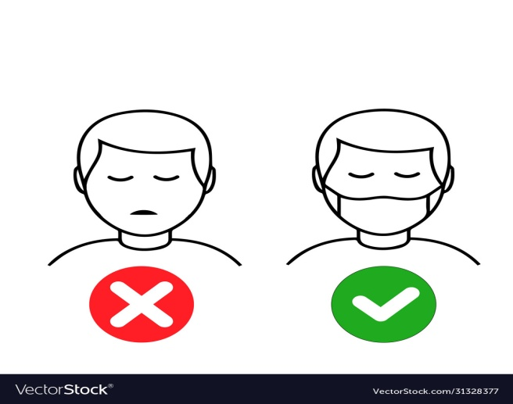


not wearing mask is a one of the most important factor of having COVID-19 positive among people living in the Dhaka City, 2022
Not wearing mask is a one of the most important associated factor of having COVID-19 positive among people living in the Dhaka City, 2022

Slide 15
Not wearing mask is a one of the most important associated factor of having COVID-19 positive among people living in the Dhaka City, 2022

Slide 16
Not wearing mask is a one of the most important associated factor of having COVID-19 positive among people living in the Dhaka City, 2022
Having COVID-19 positive
1 = Positive
0 = Negative
Not wearing mask
1 = Not wearing mask
0 = Wearing mask

Slide 17
Not wearing mask is a one of the most important associated factor of having COVID-19 positive among people living in the Dhaka City, 2022
H₀: OR=1; H₁: OR<1 or OR>1

Slide 18
Not wearing mask is a one of the most important associated factor of having COVID-19 positive among people living in the Dhaka City, 2022
H₀: OR=1; H₁: OR<1 or OR>1
How to test the hypothesis?

Slide 19
Proportion/Odds will calculated using 2 x 2 table/ Cross table
Logistic linear regression

Slide 20
Which design is appropriate???
Cross-sectional study
Randomized control trial
Cohort study
Case-control study

Slide 21
Which design is appropriate???
Cross-sectional study
Randomized control trial
Cohort study
Case-control study
Not wearing mask is a one of the most important associated factor of having COVID-19 positive among people living in the Dhaka City, 2022
Objectives should be 'SMART’
Specific, Measurable, Achievable, Realistic and Time-bound

Slide 22
Case
Outcome variable→ Having COVID-19 positive
1 = Positive
0 = Negative
Not wearing mask ←Exposure Variable
1 = Not wearing mask
0 = Wearing mask
Control

Slide 23
Case
RR is not applicable for case-control study
Log linear is not applicable for case-control study
Control

Slide 24
Case
RR is not applicable for case-control study
Log linear is not applicable for case-control study
Risk i.e. Pr(Case) is pre-defined
Control

Slide 25
Case
We can use Odds Ratio as a strength of association
OR is applicable for case-control study
Logistic regression is applicable for case-control study
Control

Slide 26
Not wearing mask is a one of the most important associated factor of having COVID-19 positive among people living in the Dhaka City, 2022
a | b
c | d

Slide 27
Not wearing mask is a one of the most important associated factor of having COVID-19 positive among people living in the Dhaka City, 2022
a | b
c | d
OR = | ad
 | bc

Slide 28
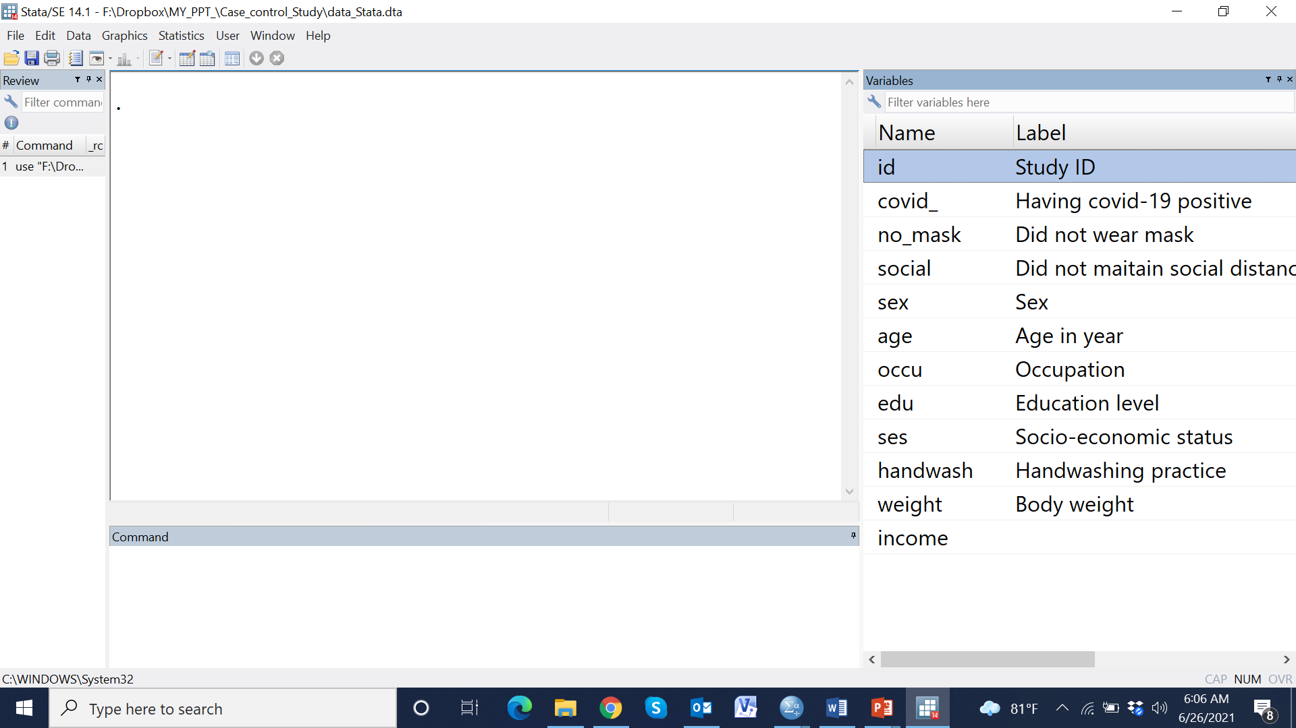

Slide 30
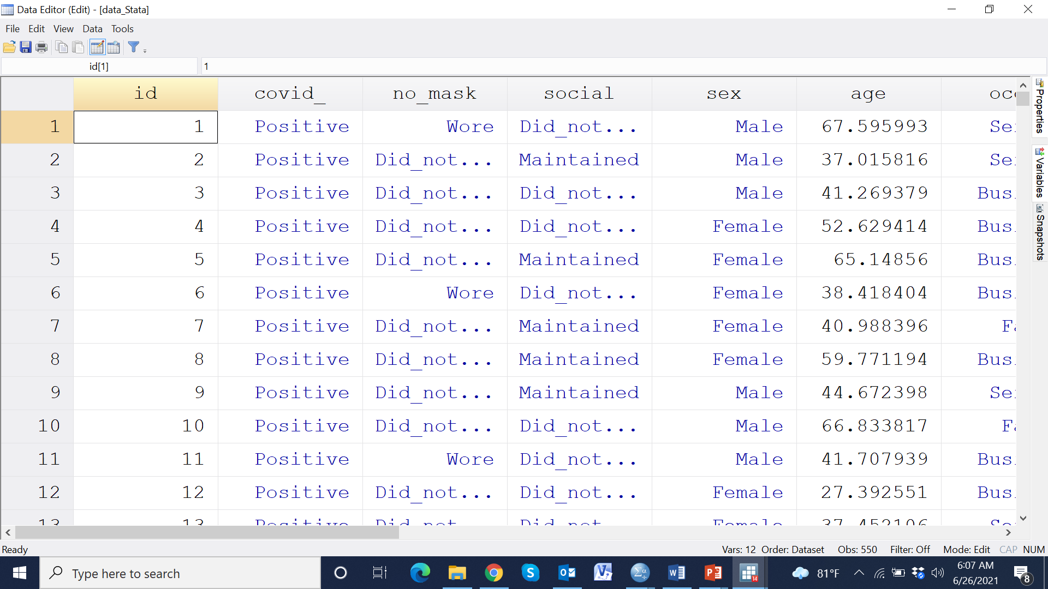

Slide 31
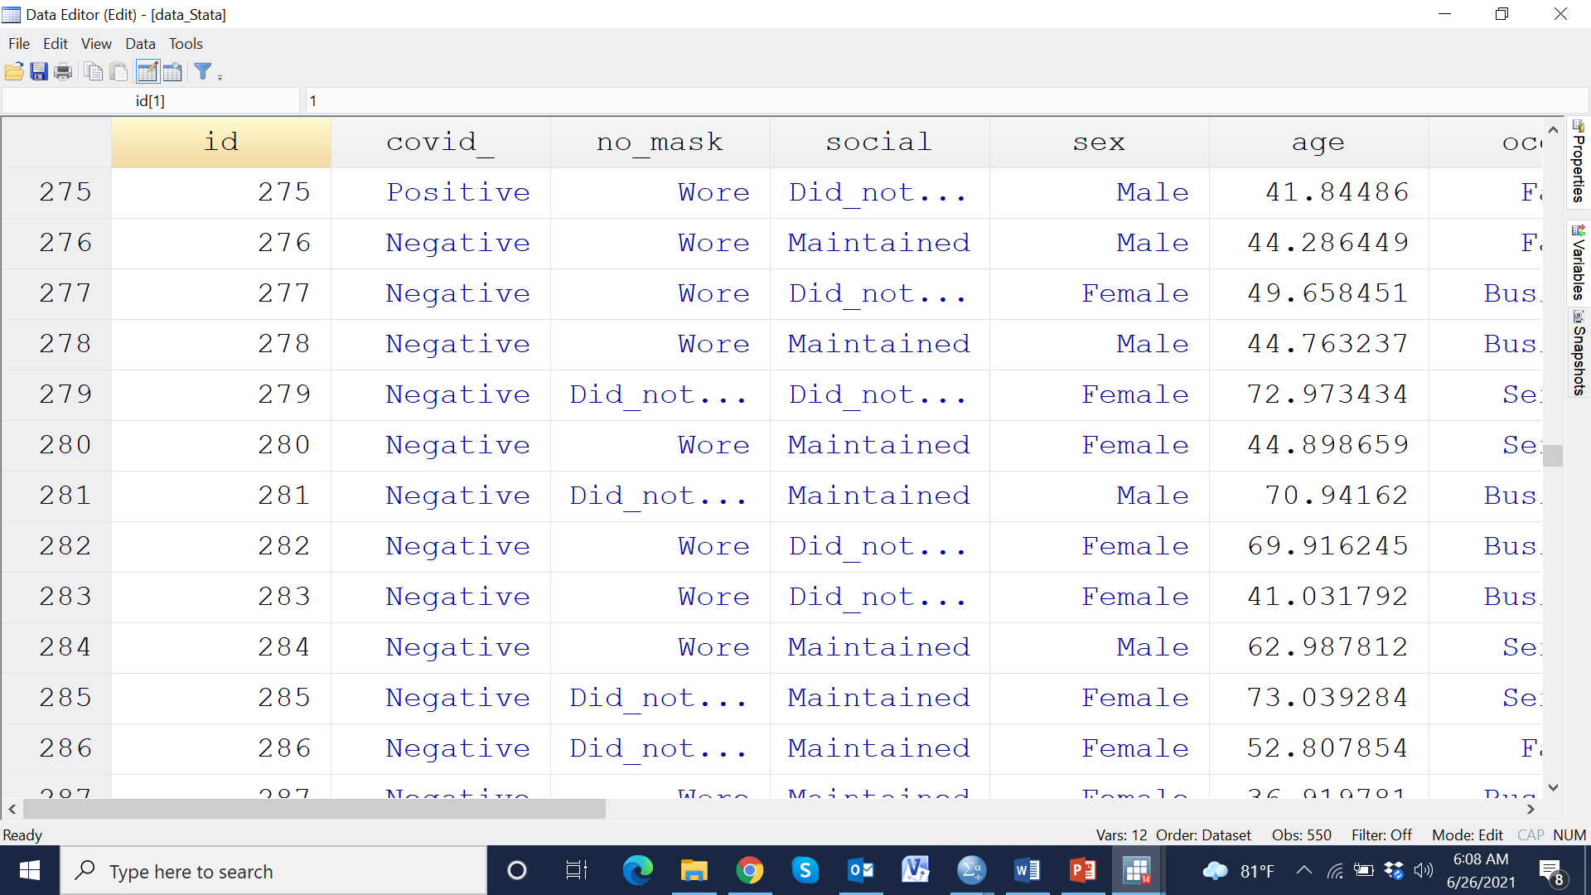

Slide 33
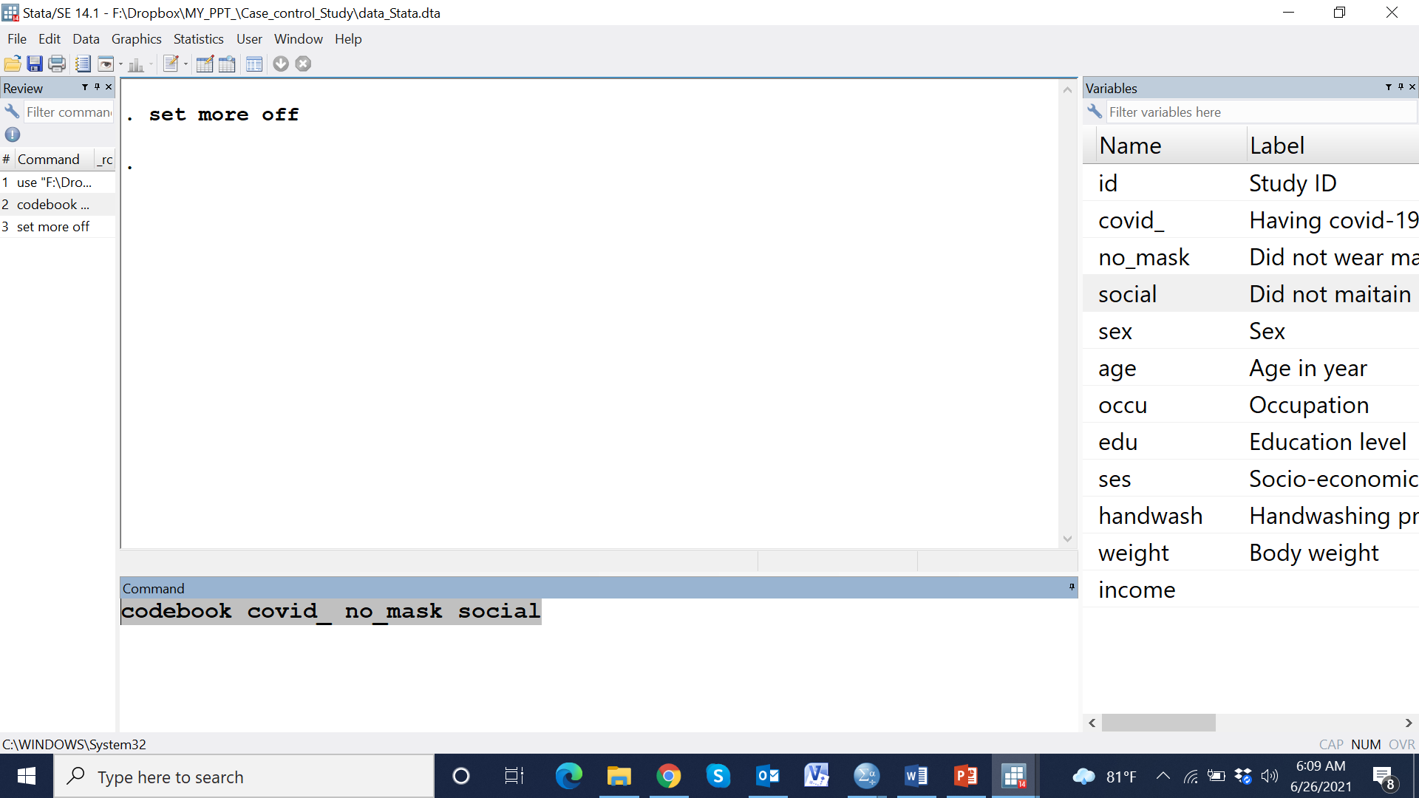

Slide 34
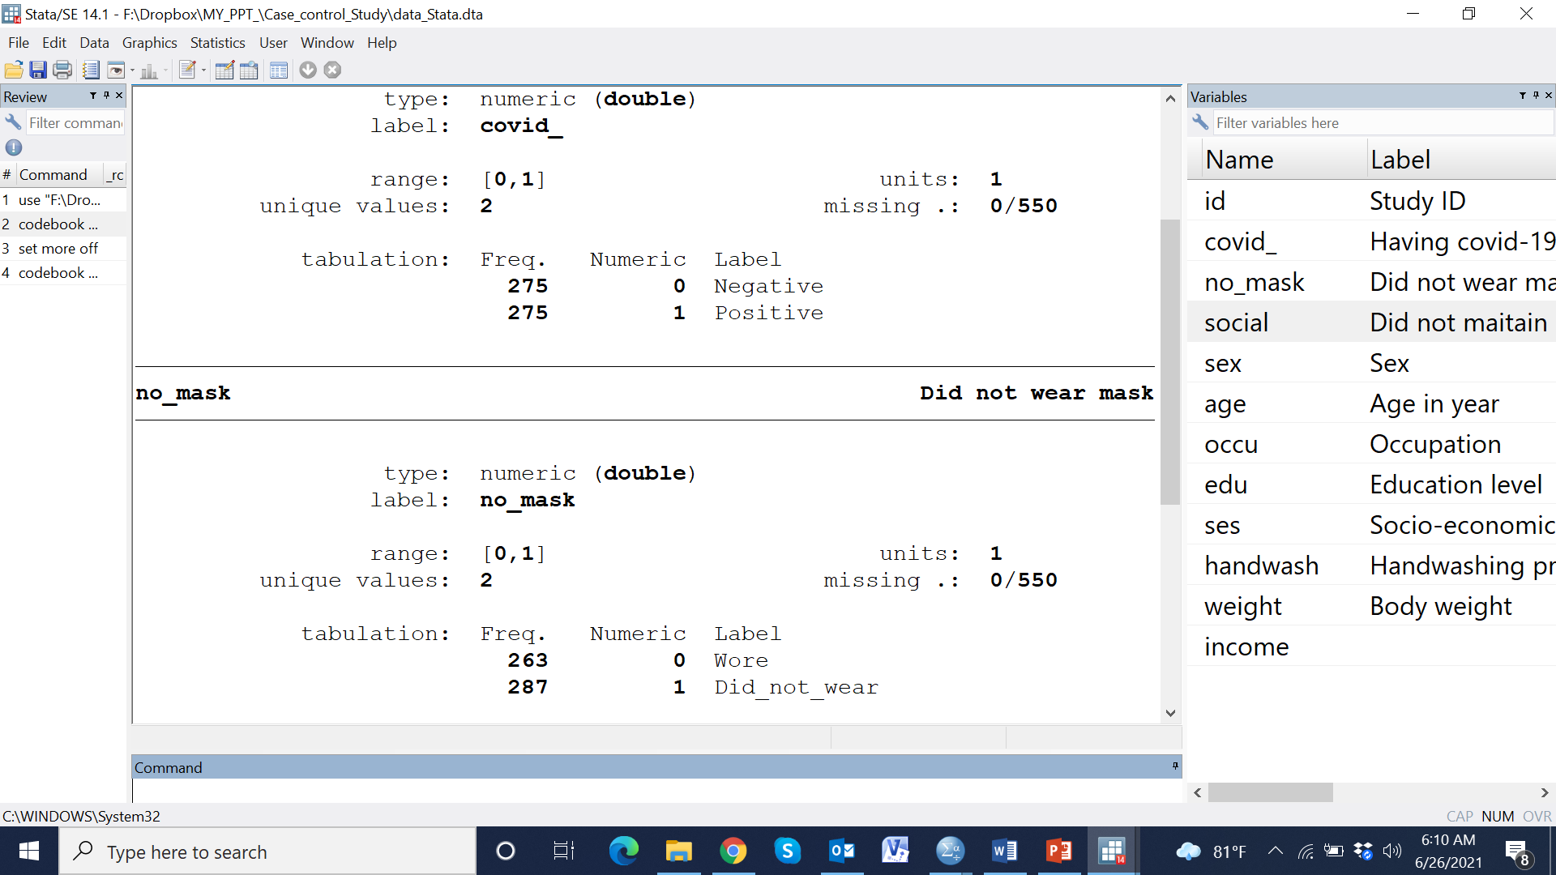

Slide 35
Having COVID-19 positive
1 = Positive
0 = Negative

Slide 37
Not wearing mask
1 = Not wearing mask
0 = Wearing mask

Slide 38
Descriptive findings

Slide 39
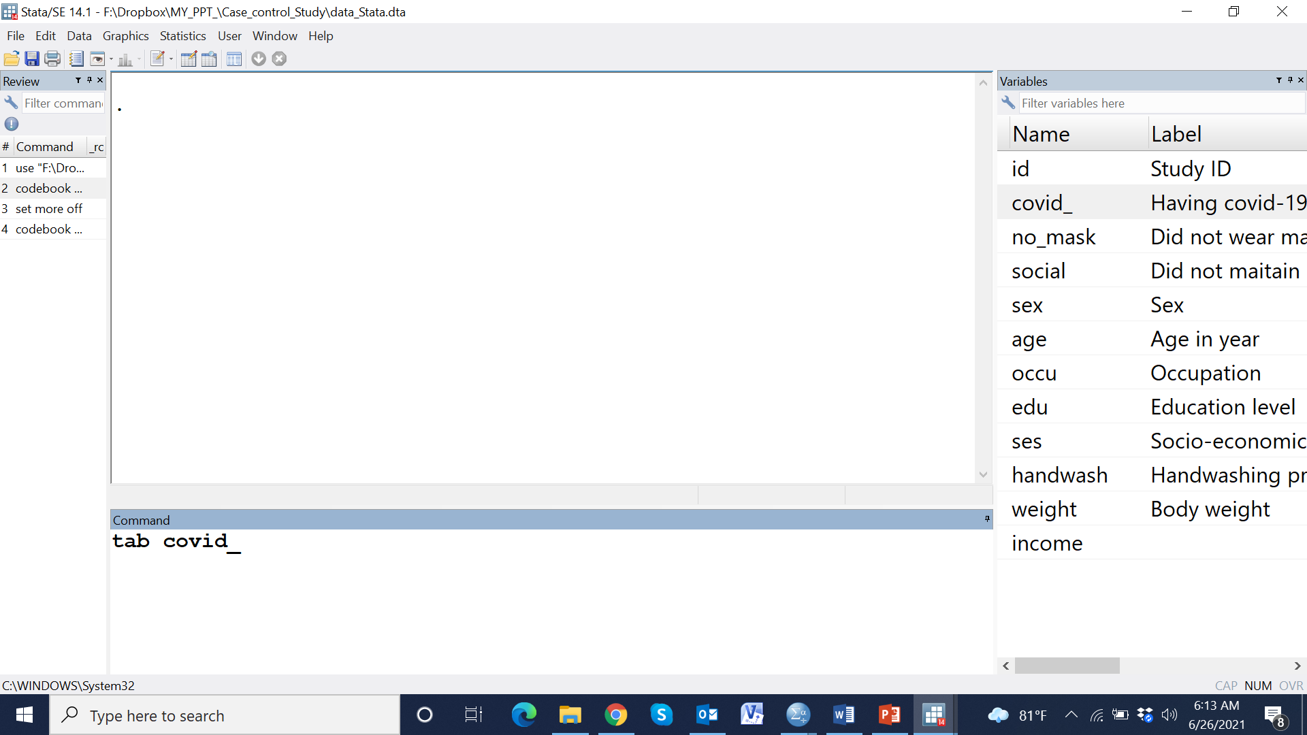

Slide 40
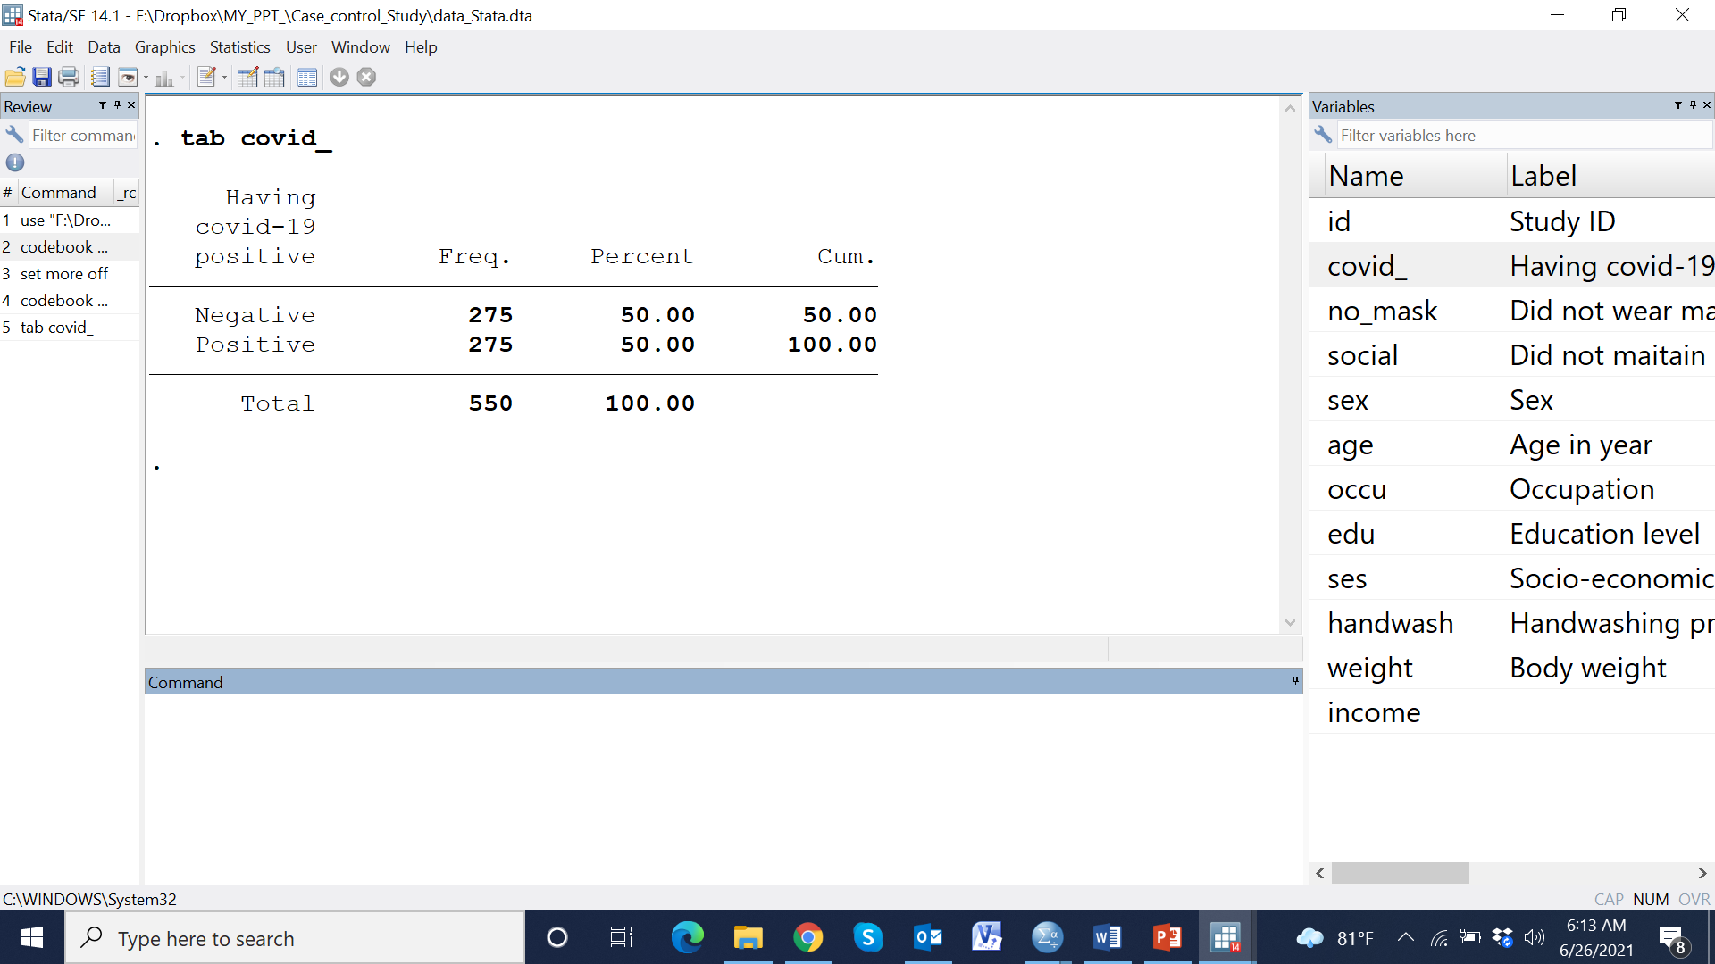

Slide 41
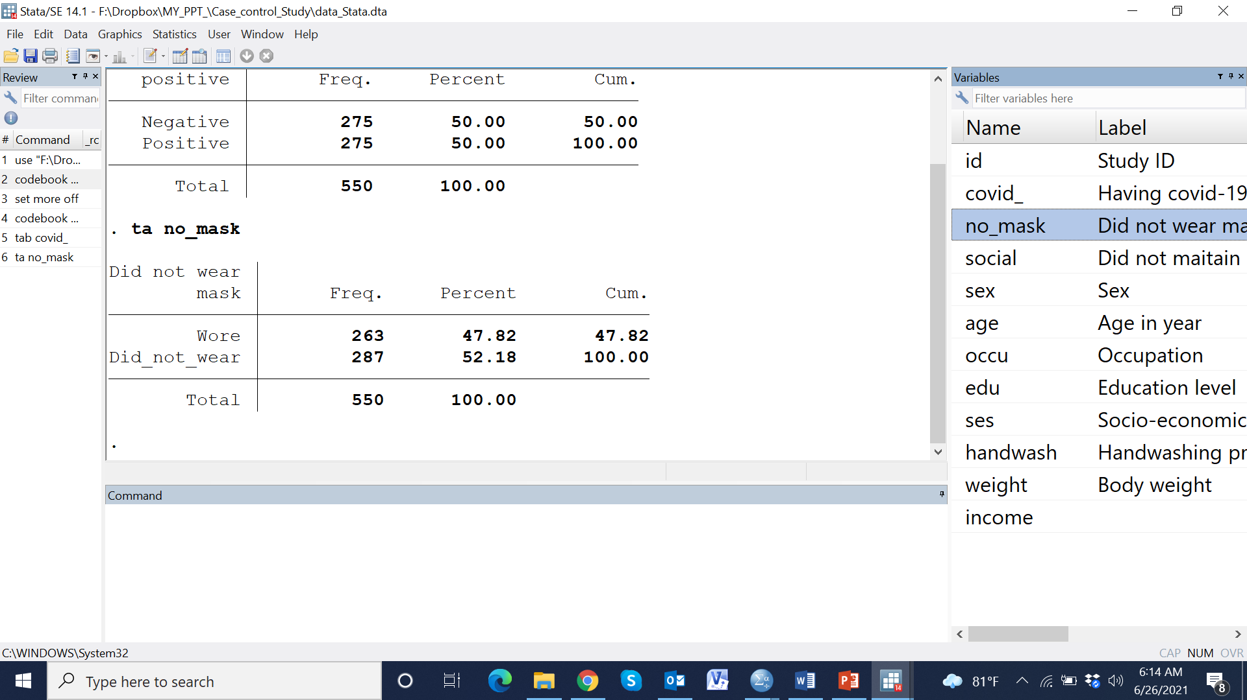

Slide 42
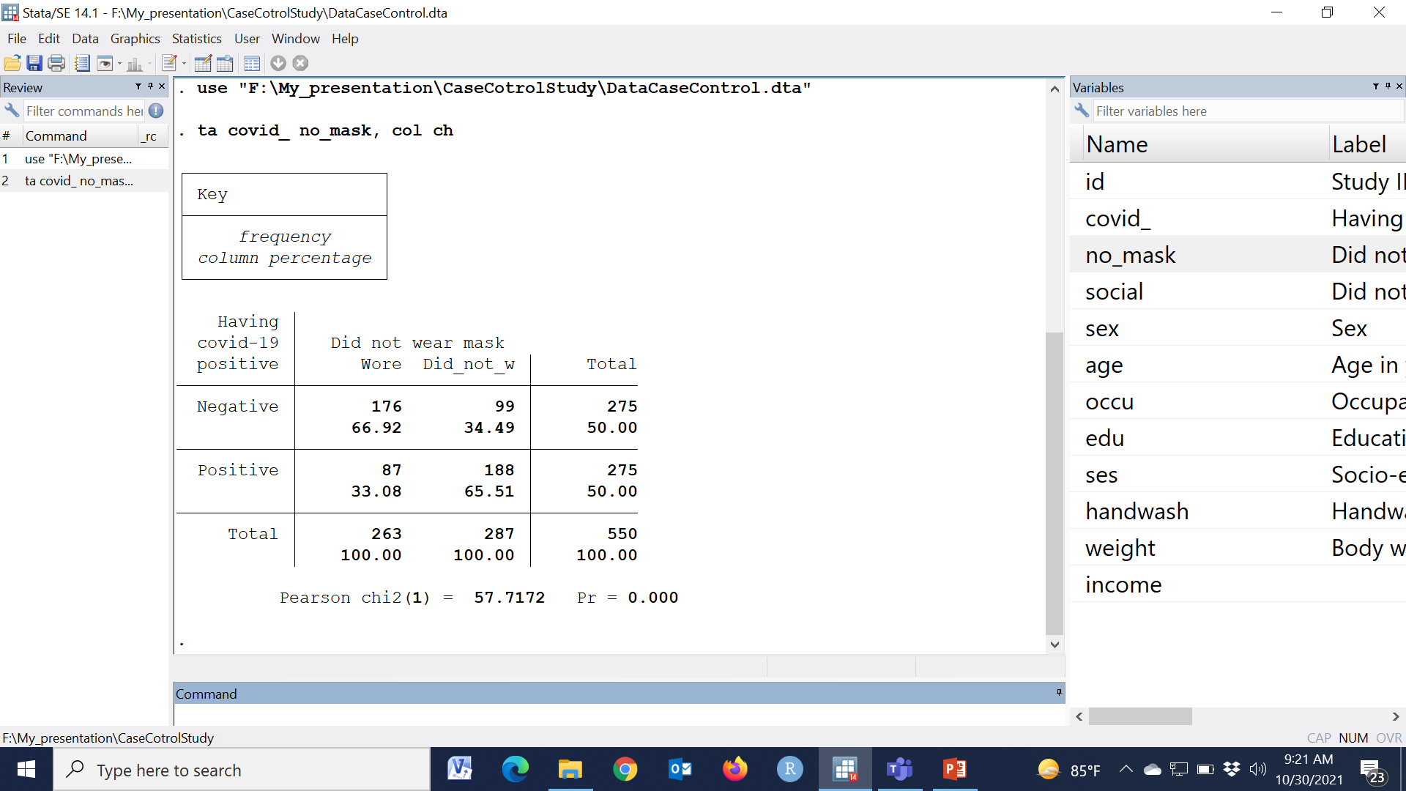

Slide 43
Meaning less

Slide 44
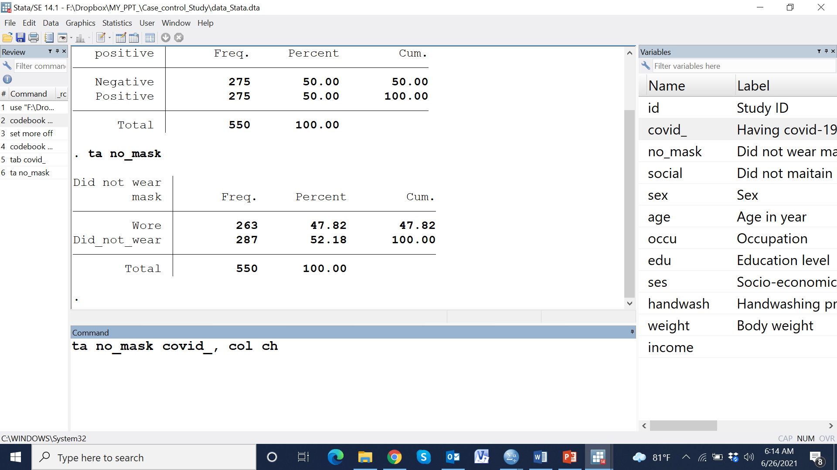

Slide 45
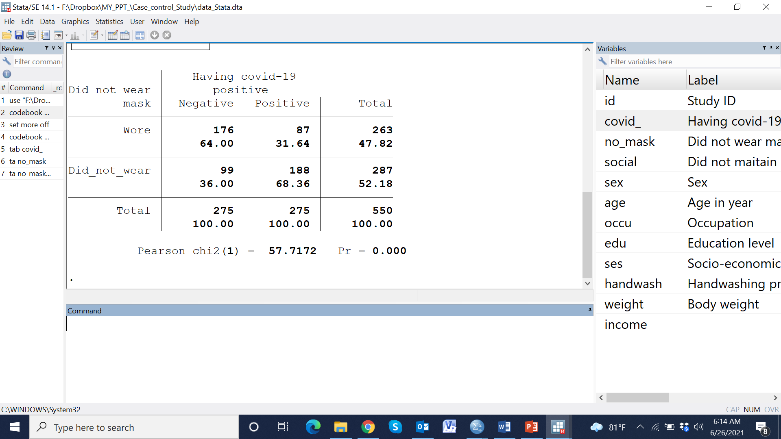

Slide 48
Indicators |  | Negative (275) | Positive (275) | All ( 550) | p-value
Did not wear mask |  | 99 (36.0) | 188 (68.4) | 287 (52.2) | <0.001
Did not maintain social distance |  | 86 (31.3) | 162 (58.9) | 248 (45.1) | <0.001
Female sex |  | 130 (47.3) | 149 (54.2) | 279 (50.7) | 0.105
Age in year (Mean±SD) |  | 50.1±0.72 | 50.9±0.73 | 50.5±0.51 | 0.441
Occupation
 | Farmer | 114 (41.5) | 55 (20.0) | 169 (30.7) | <0.001
 | Business | 130 (47.3) | 111 (40.4) | 241 (43.8)
 | Service | 31 (11.3) | 109 (39.6) | 140 (25.5)
Education
 | No education | 75 (27.3) | 30 (10.9) | 105 (19.1) | <0.001
 | Primary complete | 126 (45.8) | 86 (31.3) | 212 (38.5)
 | Secondary complete | 64 (23.3) | 111 (40.4) | 175 (31.8)
 | Higher | 10 (3.6) | 48 (17.5) | 58 (10.5)
SES
 | Poor | 88 (32) | 37 (13.5) | 125 (22.7) | <0.001
 | Middle | 133 (48.4) | 120 (43.6) | 253 (46)
 | Rich | 54 (19.6) | 118 (42.9) | 172 (31.3)
Washed their hand |  | 137 (49.8) | 175 (63.6) | 312 (56.7) | 0.001
Body weight in kg |  | 73.1±0.42 | 61.5±0.59 | 67.3±0.44 | 0.441
Monthly income in thousand Taka (Median, IQR) |  | 61 (57, 67) | 60 (57, 66) | 61 (57, 67) | 0.681

Slide 49
Indicators |  | Negative (275) | Positive (275) | All ( 550) | p-value
Did not wear mask |  | 99 (36.0) | 188 (68.4) | 287 (52.2) | <0.001
Did not maintain social distance |  | 86 (31.3) | 162 (58.9) | 248 (45.1) | <0.001
Female sex |  | 130 (47.3) | 149 (54.2) | 279 (50.7) | 0.105
Age in year (Mean±SD) |  | 50.1±0.72 | 50.9±0.73 | 50.5±0.51 | 0.441
Occupation
 | Farmer | 114 (41.5) | 55 (20.0) | 169 (30.7) | <0.001
 | Business | 130 (47.3) | 111 (40.4) | 241 (43.8)
 | Service | 31 (11.3) | 109 (39.6) | 140 (25.5)
Education
 | No education | 75 (27.3) | 30 (10.9) | 105 (19.1) | <0.001
 | Primary complete | 126 (45.8) | 86 (31.3) | 212 (38.5)
 | Secondary complete | 64 (23.3) | 111 (40.4) | 175 (31.8)
 | Higher | 10 (3.6) | 48 (17.5) | 58 (10.5)
SES
 | Poor | 88 (32) | 37 (13.5) | 125 (22.7) | <0.001
 | Middle | 133 (48.4) | 120 (43.6) | 253 (46)
 | Rich | 54 (19.6) | 118 (42.9) | 172 (31.3)
Washed their hand |  | 137 (49.8) | 175 (63.6) | 312 (56.7) | 0.001
Body weight in kg |  | 73.1±0.42 | 61.5±0.59 | 67.3±0.44 | 0.441
Monthly income in thousand Taka (Median, IQR) |  | 61 (57, 67) | 60 (57, 66) | 61 (57, 67) | 0.681

Slide 50
Indicators |  | Negative (275) | Positive (275) | All ( 550) | p-value
Did not wear mask |  | 99 (36.0) | 188 (68.4) | 287 (52.2) | <0.001
Did not maintain social distance |  | 86 (31.3) | 162 (58.9) | 248 (45.1) | <0.001
Female sex |  | 130 (47.3) | 149 (54.2) | 279 (50.7) | 0.105
Age in year (Mean±SD) |  | 50.1±0.72 | 50.9±0.73 | 50.5±0.51 | 0.441
Occupation
 | Farmer | 114 (41.5) | 55 (20.0) | 169 (30.7) | <0.001
 | Business | 130 (47.3) | 111 (40.4) | 241 (43.8)
 | Service | 31 (11.3) | 109 (39.6) | 140 (25.5)
Education
 | No education | 75 (27.3) | 30 (10.9) | 105 (19.1) | <0.001
 | Primary complete | 126 (45.8) | 86 (31.3) | 212 (38.5)
 | Secondary complete | 64 (23.3) | 111 (40.4) | 175 (31.8)
 | Higher | 10 (3.6) | 48 (17.5) | 58 (10.5)
SES
 | Poor | 88 (32) | 37 (13.5) | 125 (22.7) | <0.001
 | Middle | 133 (48.4) | 120 (43.6) | 253 (46)
 | Rich | 54 (19.6) | 118 (42.9) | 172 (31.3)
Washed their hand |  | 137 (49.8) | 175 (63.6) | 312 (56.7) | 0.001
Body weight in kg |  | 73.1±0.42 | 61.5±0.59 | 67.3±0.44 | 0.441
Monthly income in thousand Taka (Median, IQR) |  | 61 (57, 67) | 60 (57, 66) | 61 (57, 67) | 0.681

Slide 52


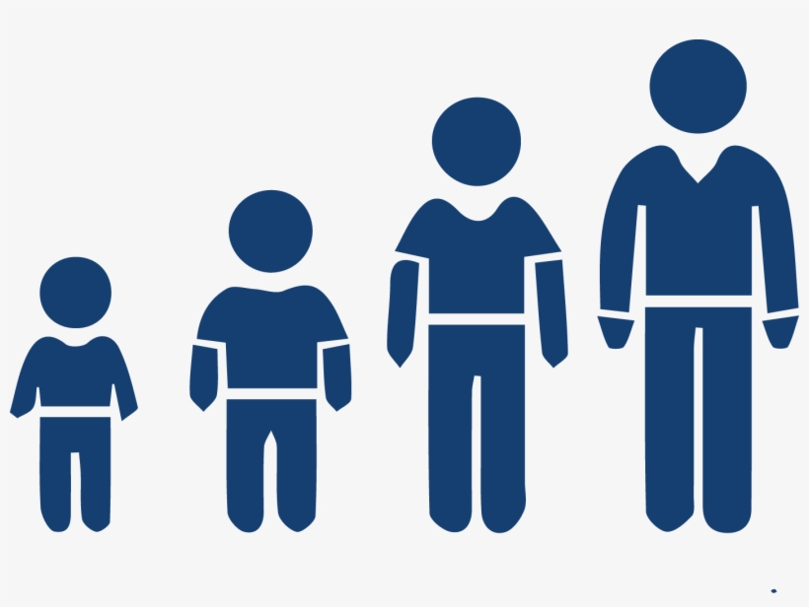


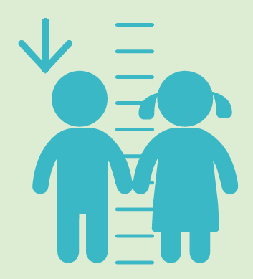

Slide 53
Indicators |  | Negative (275) | Positive (275) | All ( 550) | p-value
Did not wear mask |  | 99 (36.0) | 188 (68.4) | 287 (52.2) | <0.001
Did not maintain social distance |  | 86 (31.3) | 162 (58.9) | 248 (45.1) | <0.001
Female sex |  | 130 (47.3) | 149 (54.2) | 279 (50.7) | 0.105
Age in year (Mean±SD) |  | 50.1±0.72 | 50.9±0.73 | 50.5±0.51 | 0.441
Occupation
 | Farmer | 114 (41.5) | 55 (20.0) | 169 (30.7) | <0.001
 | Business | 130 (47.3) | 111 (40.4) | 241 (43.8)
 | Service | 31 (11.3) | 109 (39.6) | 140 (25.5)
Education
 | No education | 75 (27.3) | 30 (10.9) | 105 (19.1) | <0.001
 | Primary complete | 126 (45.8) | 86 (31.3) | 212 (38.5)
 | Secondary complete | 64 (23.3) | 111 (40.4) | 175 (31.8)
 | Higher | 10 (3.6) | 48 (17.5) | 58 (10.5)
SES
 | Poor | 88 (32) | 37 (13.5) | 125 (22.7) | <0.001
 | Middle | 133 (48.4) | 120 (43.6) | 253 (46)
 | Rich | 54 (19.6) | 118 (42.9) | 172 (31.3)
Washed their hand |  | 137 (49.8) | 175 (63.6) | 312 (56.7) | 0.001
Body weight in kg (Mean±SD) |  | 73.1±0.42 | 61.5±0.59 | 67.3±0.44 | 0.441
Monthly income in thousand Taka (Median, IQR) |  | 61 (57, 67) | 60 (57, 66) | 61 (57, 67) | 0.681

Slide 56
OR
=(176*188)/(87*99)
=3.84

Slide 57
95% CI = ???
OR
=(176*188)/(87*99)
=3.84

Slide 58
95% CI = ???
Adjusted OR =??
OR
=(176*188)/(87*99)
=3.84

Slide 59
Logistic Regression analysis

Slide 60
Logistic Regression analysis
Logistic regression is a predictive analysis
The dependent variable is dichotomous
Explain the relationship between one dependent binary variable and one or more nominal, ordinal, interval or ratio-level independent variables
Risk ratio or Risk difference also calculated

Slide 61
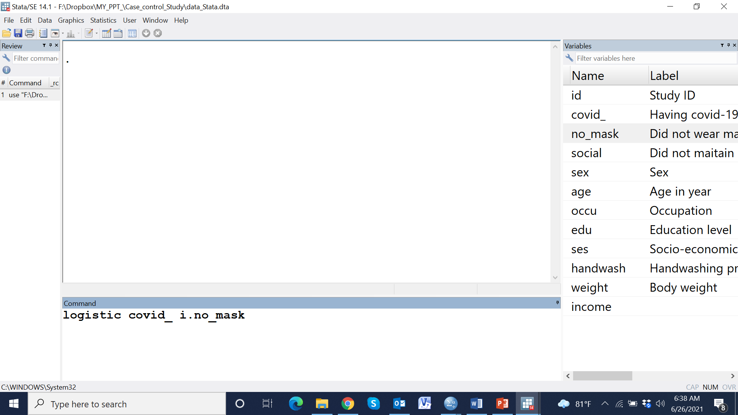

Slide 64
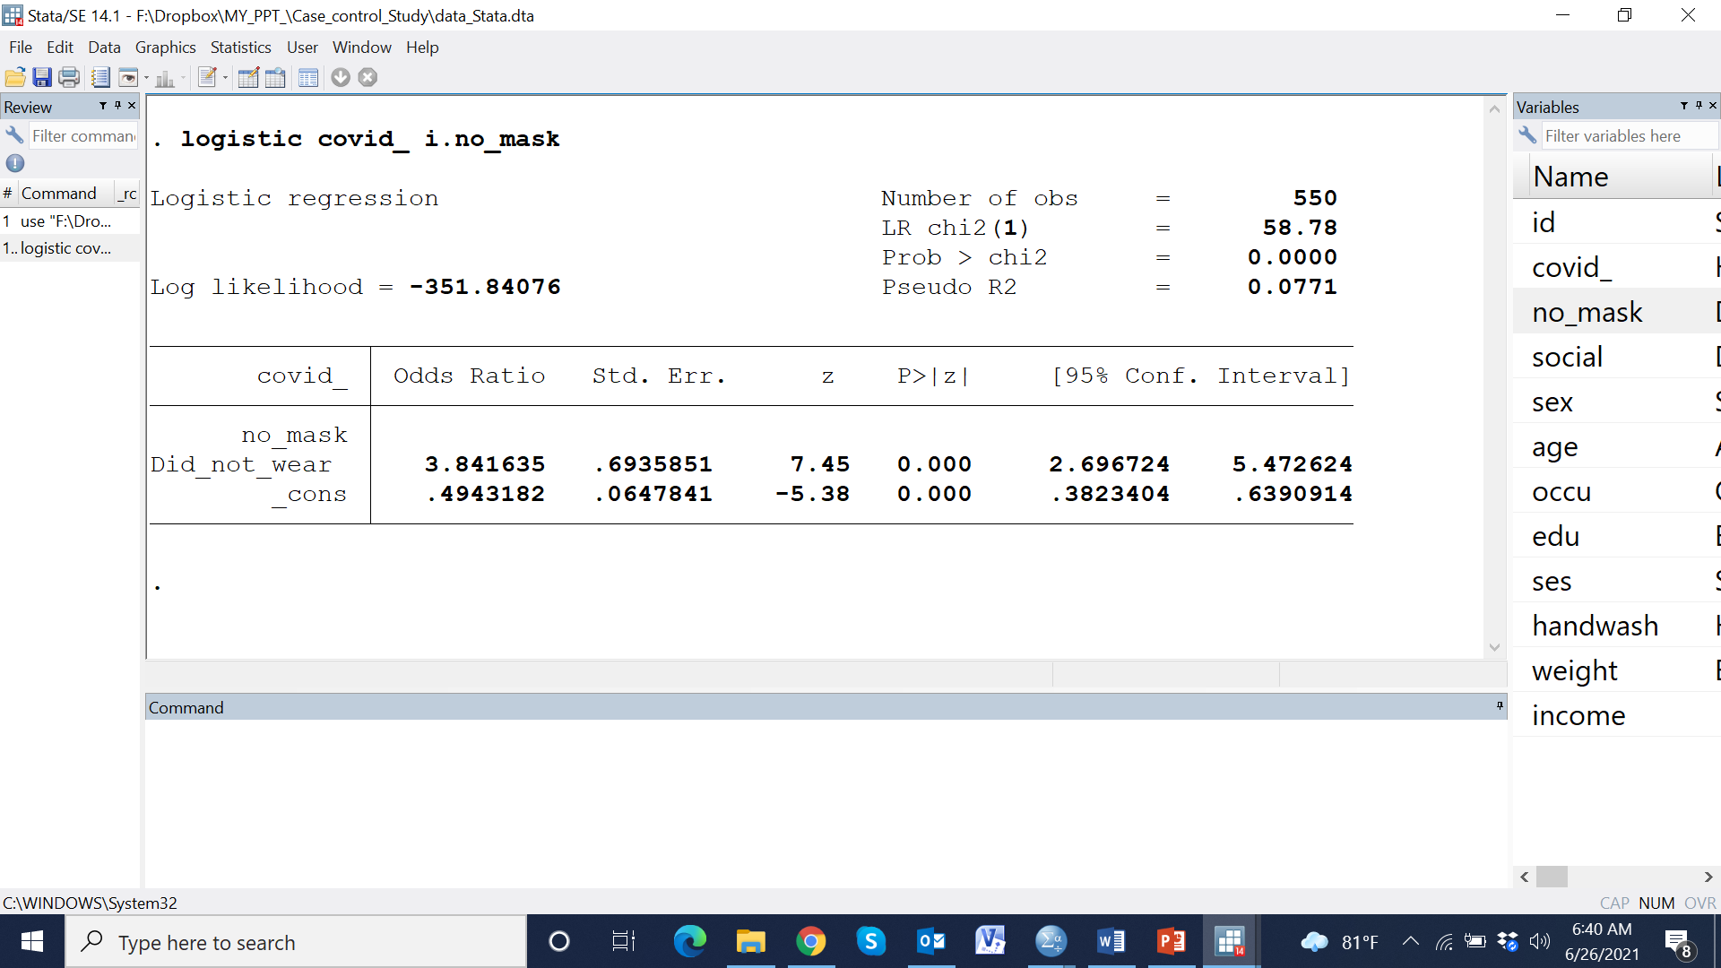

Slide 65
Odds ratio

Slide 66
Odds ratio
P-value

Slide 67
Odds ratio
P-value
95% CI

Slide 68
Odds ratio
P-value
95% CI
Independent variables |  | Unadjusted OR (95% CI) | p-value | Adjusted OR (95%) CI | p-value
Wearing mask
 | Wore mask | Reference |  | Reference
 | Did not wear mask | 3.84 (2.70, 5.47) | <0.001 | 4.06 (2.51, 6.55) | <0.001
Maintaining social distance
 | Maintained social distance | Reference |  | Reference
 | Did not maintain social distance | 3.15 (2.22, 4.47) | <0.001 | 2.61 (1.62, 4.2) | <0.001
Sex of respondence
 | Male | Reference |  | Reference
 | Female | 0.76 (0.54, 1.06) | 0.105 | 0.72 (0.45, 1.15) | 0.167
Age in year |  | 0.99 (0.98, 1.01) | 0.44 | 1.00 (0.98, 1.02) | 0.782
Education level
 | No schooling | Reference |  | Reference
 | Primary complete | 1.71 (1.03, 2.83) | 0.038 | 1.80 (0.91, 3.55) | 0.092
 | Secondary complete | 4.34 (2.57, 7.32) | <0.001 | 3.67 (1.82, 7.40) | <0.001
 | Higher | 12.0 (5.38, 26.76) | 0.001 | 8.43 (3.13, 22.7) | <0.001
SES
 | poor | Reference |  | Reference
 | Middle | 2.15 (1.36, 3.39) | <0.001 | 1.97 (1.07, 3.65) | 0.030
 | Rich | 5.20 (3.15, 8.58) | <0.001 | 4.54 (2.32, 8.90) | <0.001
Washed their hand
 | No | Reference |  | Reference
 | Yes | 0.57 (0.40, 0.80) | <0.001 | 0.55 (0.34, 0.88) | 0.014
Body weight in kg |  | 1.16 (1.13, 1.19) | <0.001 | 1.15 (1.11, 1.18) | <0.001

Slide 69
Independent variables |  | Unadjusted OR (95% CI) | p-value | Adjusted OR (95%) CI | p-value
Wearing mask
 | Wore mask | Reference |  | Reference
 | Did not wear mask | 3.84 (2.70, 5.47) | <0.001 | 4.06 (2.51, 6.55) | <0.001
Maintaining social distance
 | Maintained social distance | Reference |  | Reference
 | Did not maintain social distance | 3.15 (2.22, 4.47) | <0.001 | 2.61 (1.62, 4.2) | <0.001
Sex of respondence
 | Male | Reference |  | Reference
 | Female | 0.76 (0.54, 1.06) | 0.105 | 0.72 (0.45, 1.15) | 0.167
Age in year |  | 0.99 (0.98, 1.01) | 0.44 | 1.00 (0.98, 1.02) | 0.782
Education level
 | No schooling | Reference |  | Reference
 | Primary complete | 1.71 (1.03, 2.83) | 0.038 | 1.80 (0.91, 3.55) | 0.092
 | Secondary complete | 4.34 (2.57, 7.32) | <0.001 | 3.67 (1.82, 7.40) | <0.001
 | Higher | 12.0 (5.38, 26.76) | 0.001 | 8.43 (3.13, 22.7) | <0.001
SES
 | poor | Reference |  | Reference
 | Middle | 2.15 (1.36, 3.39) | <0.001 | 1.97 (1.07, 3.65) | 0.030
 | Rich | 5.20 (3.15, 8.58) | <0.001 | 4.54 (2.32, 8.90) | <0.001
Washed their hand
 | No | Reference |  | Reference
 | Yes | 0.57 (0.40, 0.80) | <0.001 | 0.55 (0.34, 0.88) | 0.014
Body weight in kg |  | 1.16 (1.13, 1.19) | <0.001 | 1.15 (1.11, 1.18) | <0.001

Slide 72
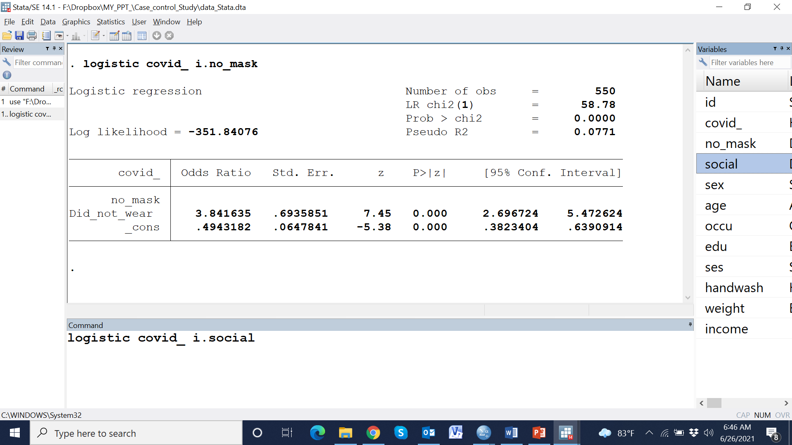

Slide 73
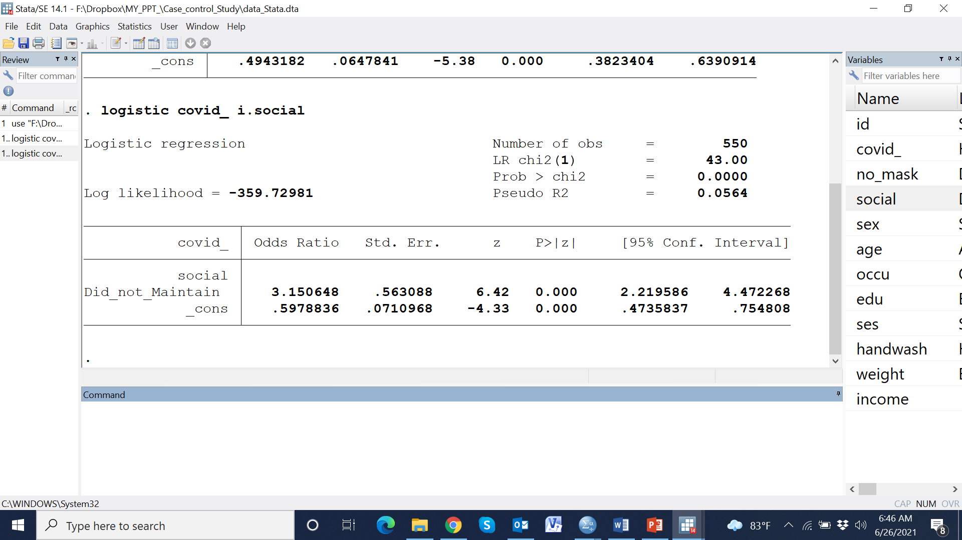

Slide 74
Independent variables |  | Unadjusted OR (95% CI) | p-value | Adjusted OR (95%) CI | p-value
Wearing mask
 | Wore mask | Reference |  | Reference
 | Did not wear mask | 3.84 (2.70, 5.47) | <0.001 | 4.06 (2.51, 6.55) | <0.001
Maintaining social distance
 | Maintained social distance | Reference |  | Reference
 | Did not maintain social distance | 3.15 (2.22, 4.47) | <0.001 | 2.61 (1.62, 4.2) | <0.001
Sex of respondence
 | Male | Reference |  | Reference
 | Female | 0.76 (0.54, 1.06) | 0.105 | 0.72 (0.45, 1.15) | 0.167
Age in year |  | 0.99 (0.98, 1.01) | 0.44 | 1.00 (0.98, 1.02) | 0.782
Education level
 | No schooling | Reference |  | Reference
 | Primary complete | 1.71 (1.03, 2.83) | 0.038 | 1.80 (0.91, 3.55) | 0.092
 | Secondary complete | 4.34 (2.57, 7.32) | <0.001 | 3.67 (1.82, 7.40) | <0.001
 | Higher | 12.0 (5.38, 26.76) | 0.001 | 8.43 (3.13, 22.7) | <0.001
SES
 | poor | Reference |  | Reference
 | Middle | 2.15 (1.36, 3.39) | <0.001 | 1.97 (1.07, 3.65) | 0.030
 | Rich | 5.20 (3.15, 8.58) | <0.001 | 4.54 (2.32, 8.90) | <0.001
Washed their hand
 | No | Reference |  | Reference
 | Yes | 0.57 (0.40, 0.80) | <0.001 | 0.55 (0.34, 0.88) | 0.014
Body weight in kg |  | 1.16 (1.13, 1.19) | <0.001 | 1.15 (1.11, 1.18) | <0.001

Slide 76
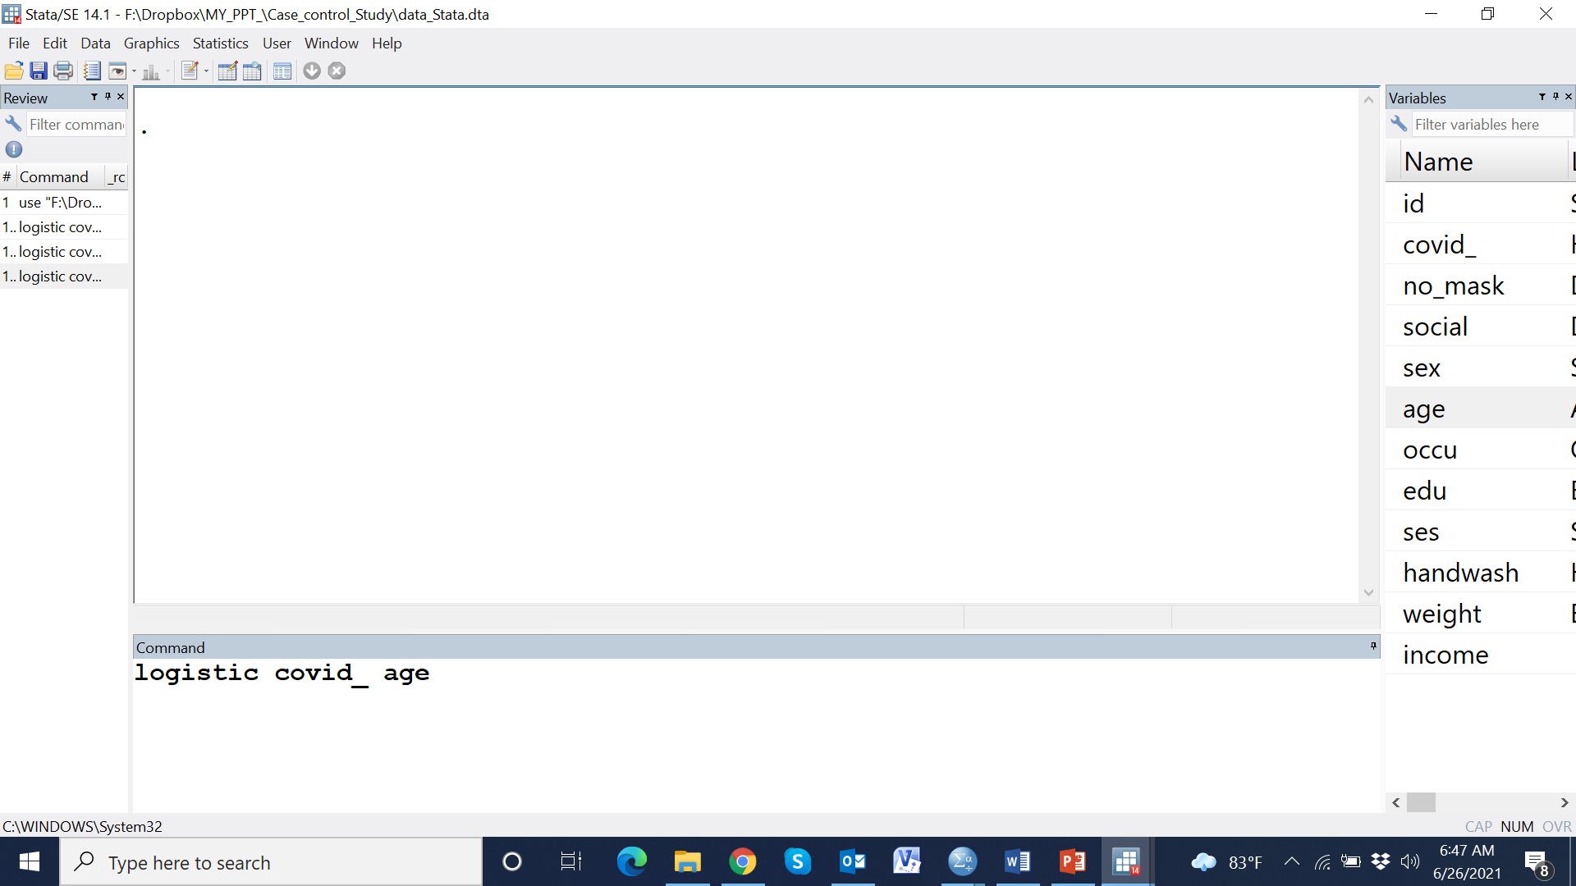

Slide 77
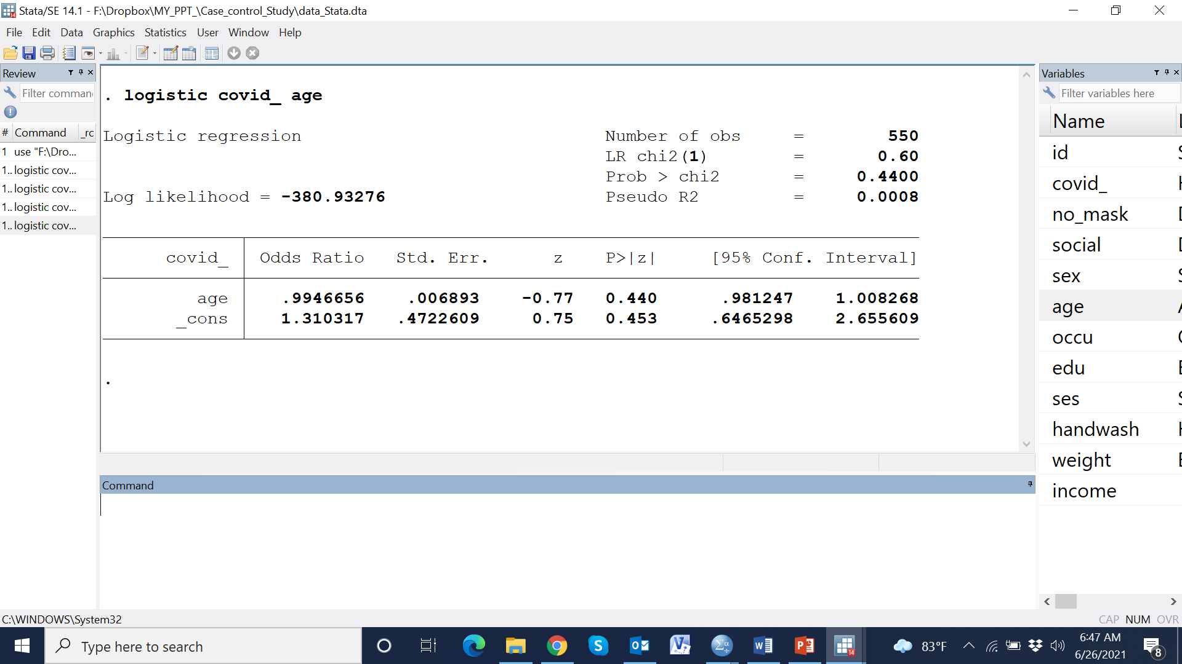

Slide 78
Independent variables |  | Unadjusted OR (95% CI) | p-value | Adjusted OR (95%) CI | p-value
Wearing mask
 | Wore mask | Reference |  | Reference
 | Did not wear mask | 3.84 (2.70, 5.47) | <0.001 | 4.06 (2.51, 6.55) | <0.001
Maintaining social distance
 | Maintained social distance | Reference |  | Reference
 | Did not maintain social distance | 3.15 (2.22, 4.47) | <0.001 | 2.61 (1.62, 4.2) | <0.001
Sex of respondence
 | Male | Reference |  | Reference
 | Female | 0.76 (0.54, 1.06) | 0.105 | 0.72 (0.45, 1.15) | 0.167
Age in year |  | 0.99 (0.98, 1.01) | 0.440 | 1.00 (0.98, 1.02) | 0.782
Education level
 | No schooling | Reference |  | Reference
 | Primary complete | 1.71 (1.03, 2.83) | 0.038 | 1.80 (0.91, 3.55) | 0.092
 | Secondary complete | 4.34 (2.57, 7.32) | <0.001 | 3.67 (1.82, 7.40) | <0.001
 | Higher | 12.0 (5.38, 26.76) | 0.001 | 8.43 (3.13, 22.7) | <0.001
SES
 | poor | Reference |  | Reference
 | Middle | 2.15 (1.36, 3.39) | <0.001 | 1.97 (1.07, 3.65) | 0.030
 | Rich | 5.20 (3.15, 8.58) | <0.001 | 4.54 (2.32, 8.90) | <0.001
Washed their hand
 | No | Reference |  | Reference
 | Yes | 0.57 (0.40, 0.80) | <0.001 | 0.55 (0.34, 0.88) | 0.014
Body weight in kg |  | 1.16 (1.13, 1.19) | <0.001 | 1.15 (1.11, 1.18) | <0.001

Slide 79
Independent variables |  | Unadjusted OR (95% CI) | p-value | Adjusted OR (95%) CI | p-value
Wearing mask
 | Wore mask | Reference |  | Reference
 | Did not wear mask | 3.84 (2.70, 5.47) | <0.001 | 4.06 (2.51, 6.55) | <0.001
Maintaining social distance
 | Maintained social distance | Reference |  | Reference
 | Did not maintain social distance | 3.15 (2.22, 4.47) | <0.001 | 2.61 (1.62, 4.2) | <0.001
Sex of respondence
 | Male | Reference |  | Reference
 | Female | 0.76 (0.54, 1.06) | 0.105 | 0.72 (0.45, 1.15) | 0.167
Age in year |  | 0.99 (0.98, 1.01) | 0.44 | 1.00 (0.98, 1.02) | 0.782
Education level
 | No schooling | Reference |  | Reference
 | Primary complete | 1.71 (1.03, 2.83) | 0.038 | 1.80 (0.91, 3.55) | 0.092
 | Secondary complete | 4.34 (2.57, 7.32) | <0.001 | 3.67 (1.82, 7.40) | <0.001
 | Higher | 12.0 (5.38, 26.76) | 0.001 | 8.43 (3.13, 22.7) | <0.001
SES
 | poor | Reference |  | Reference
 | Middle | 2.15 (1.36, 3.39) | <0.001 | 1.97 (1.07, 3.65) | 0.030
 | Rich | 5.20 (3.15, 8.58) | <0.001 | 4.54 (2.32, 8.90) | <0.001
Washed their hand
 | No | Reference |  | Reference
 | Yes | 0.57 (0.40, 0.80) | <0.001 | 0.55 (0.34, 0.88) | 0.014
Body weight in kg |  | 1.16 (1.13, 1.19) | <0.001 | 1.15 (1.11, 1.18) | <0.001

Slide 80
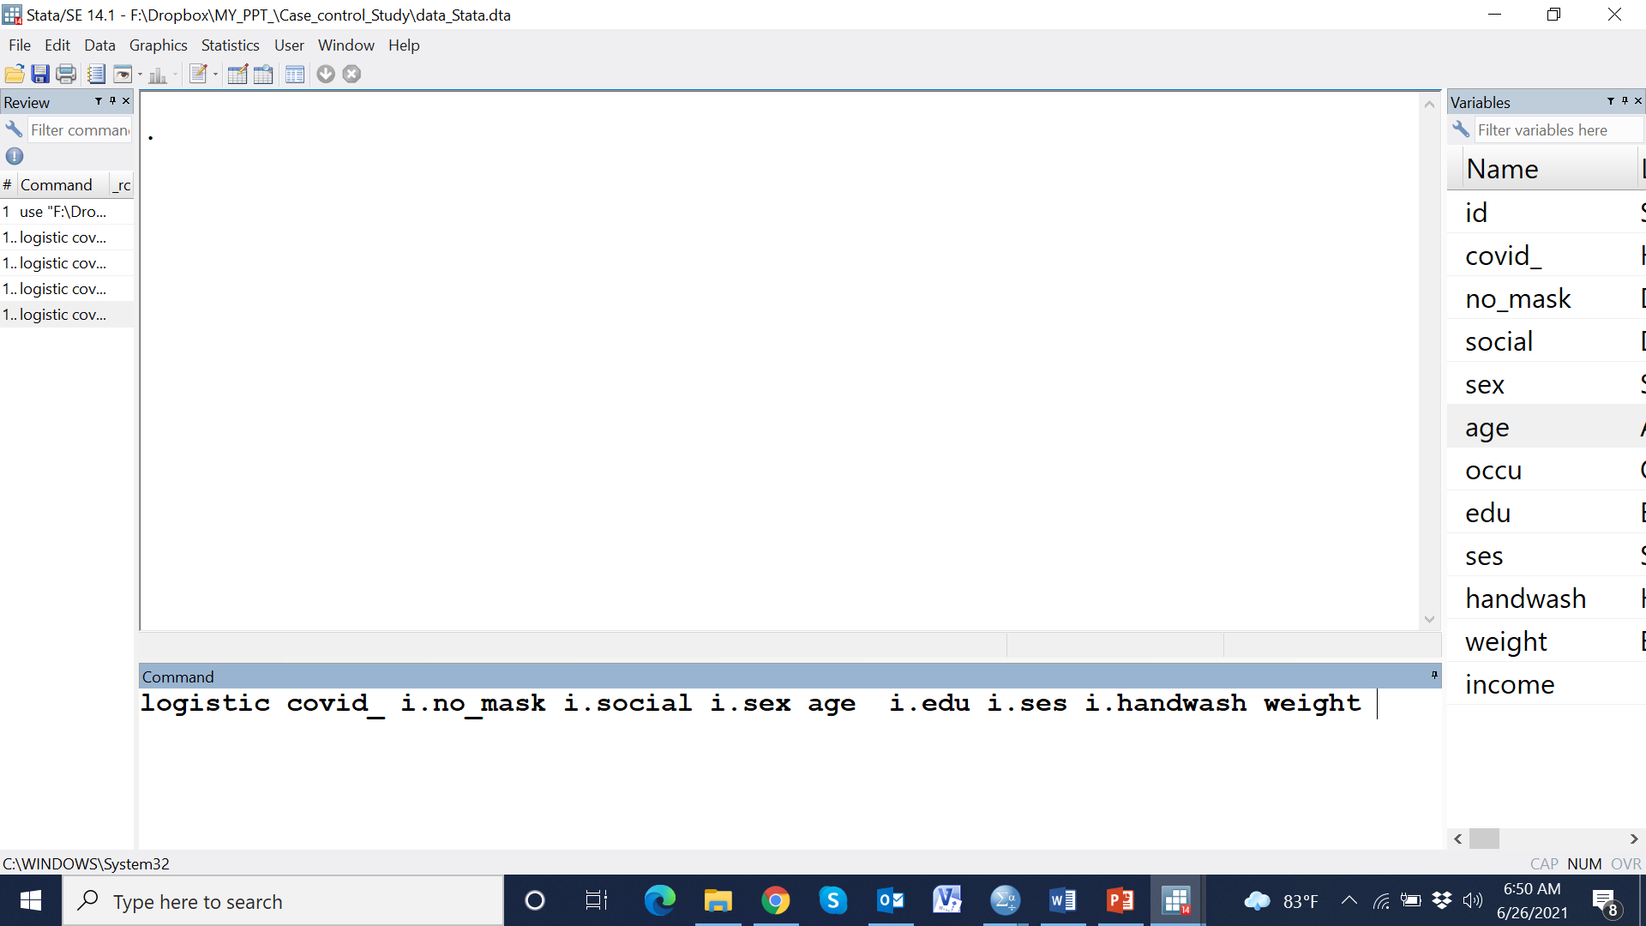

Slide 81
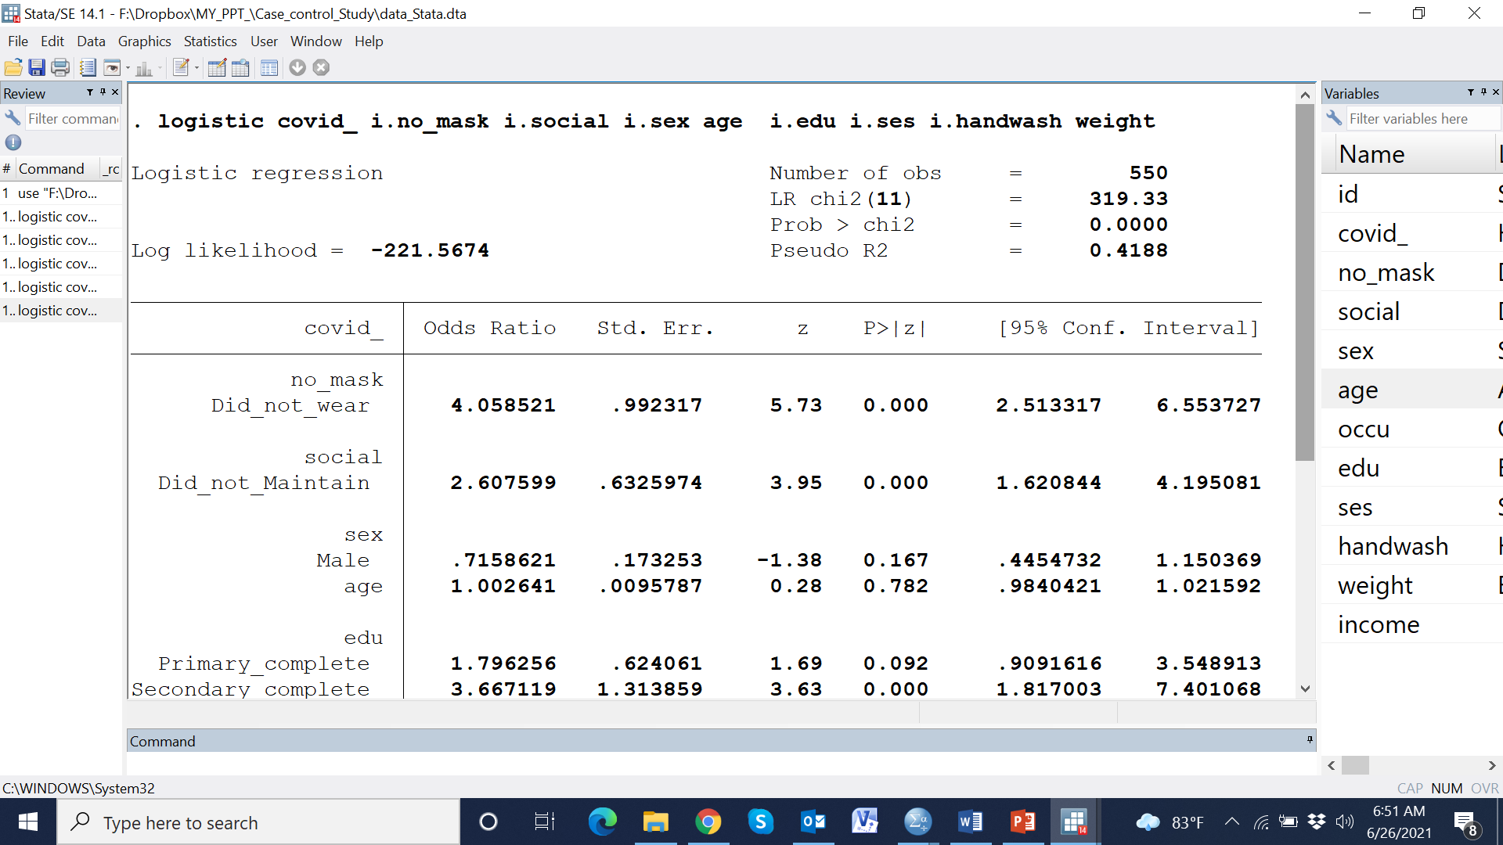

Slide 82
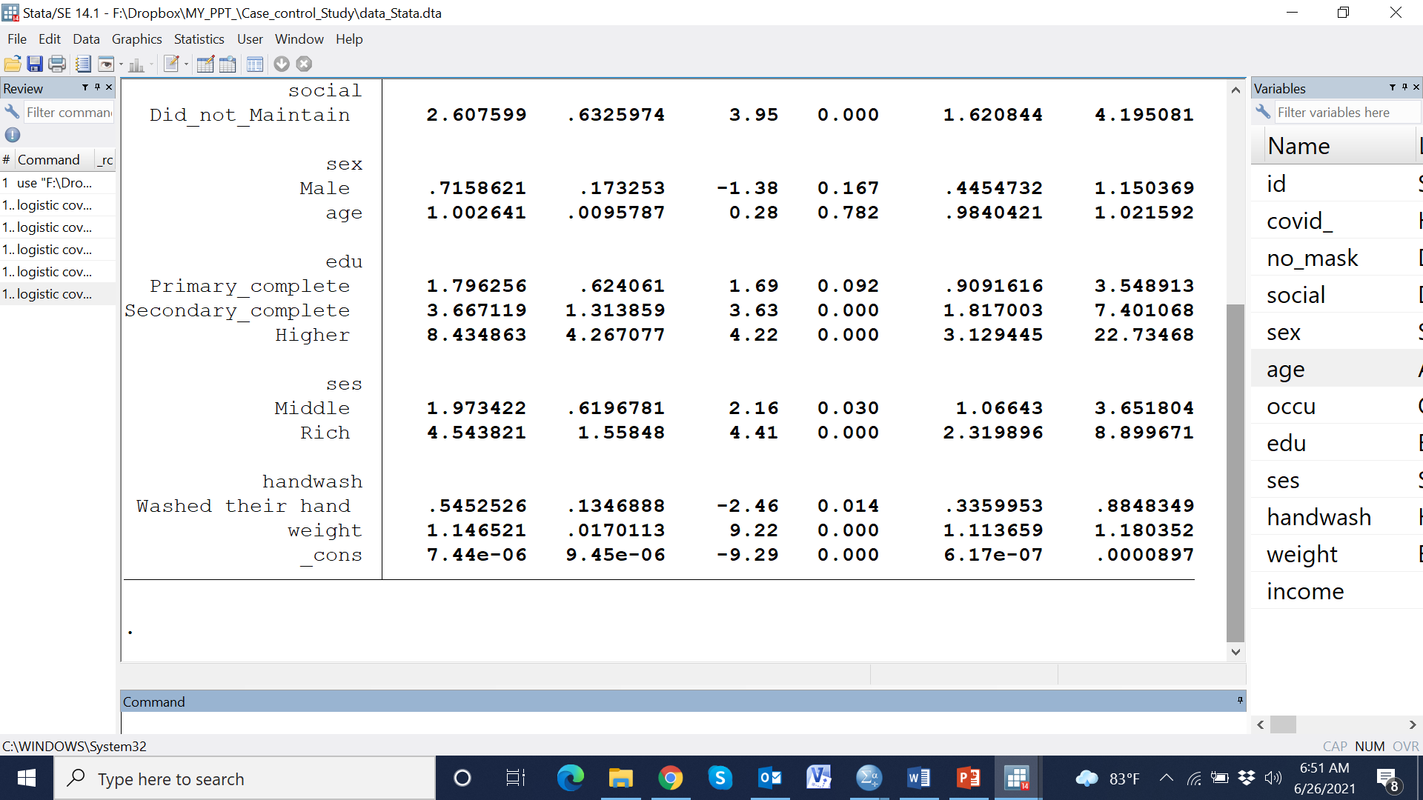

Slide 83
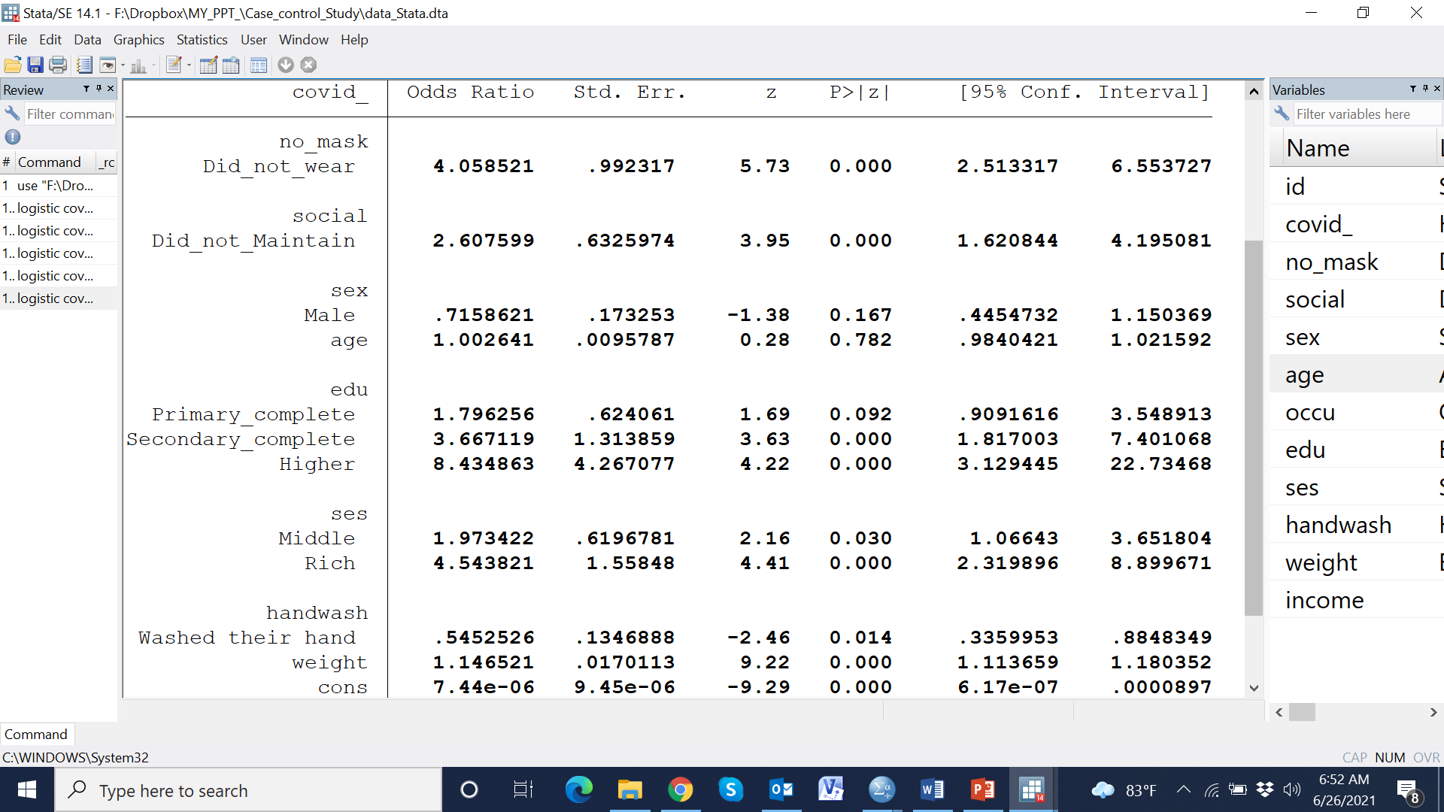

Slide 84
Independent variables |  | Unadjusted OR (95% CI) | p-value | Adjusted OR (95%) CI | p-value
Wearing mask
 | Wore mask | Reference |  | Reference
 | Did not wear mask | 3.84 (2.70, 5.47) | <0.001 | 4.06 (2.51, 6.55) | <0.001
Maintaining social distance
 | Maintained social distance | Reference |  | Reference
 | Did not maintain social distance | 3.15 (2.22, 4.47) | <0.001 | 2.61 (1.62, 4.2) | <0.001
Sex of respondence
 | Male | Reference |  | Reference
 | Female | 0.76 (0.54, 1.06) | 0.105 | 0.72 (0.45, 1.15) | 0.167
Age in year |  | 0.99 (0.98, 1.01) | 0.44 | 1.00 (0.98, 1.02) | 0.782
Education level
 | No schooling | Reference |  | Reference
 | Primary complete | 1.71 (1.03, 2.83) | 0.038 | 1.80 (0.91, 3.55) | 0.092
 | Secondary complete | 4.34 (2.57, 7.32) | <0.001 | 3.67 (1.82, 7.40) | <0.001
 | Higher | 12.0 (5.38, 26.76) | 0.001 | 8.43 (3.13, 22.7) | <0.001
SES
 | poor | Reference |  | Reference
 | Middle | 2.15 (1.36, 3.39) | <0.001 | 1.97 (1.07, 3.65) | 0.030
 | Rich | 5.20 (3.15, 8.58) | <0.001 | 4.54 (2.32, 8.90) | <0.001
Washed their hand
 | No | Reference |  | Reference
 | Yes | 0.57 (0.40, 0.80) | <0.001 | 0.55 (0.34, 0.88) | 0.014
Body weight in kg |  | 1.16 (1.13, 1.19) | <0.001 | 1.15 (1.11, 1.18) | <0.001

Slide 85
Independent variables |  | Unadjusted OR (95% CI) | p-value | Adjusted OR (95%) CI | p-value
Wearing mask
 | Wore mask | Reference |  | Reference
 | Did not wear mask | 3.84 (2.70, 5.47) | <0.001 | 4.06 (2.51, 6.55) | <0.001
Maintaining social distance
 | Maintained social distance | Reference |  | Reference
 | Did not maintain social distance | 3.15 (2.22, 4.47) | <0.001 | 2.61 (1.62, 4.2) | <0.001
Sex of respondence
 | Male | Reference |  | Reference
 | Female | 0.76 (0.54, 1.06) | 0.105 | 0.72 (0.45, 1.15) | 0.167
Age in year |  | 0.99 (0.98, 1.01) | 0.44 | 1.00 (0.98, 1.02) | 0.782
Education level
 | No schooling | Reference |  | Reference
 | Primary complete | 1.71 (1.03, 2.83) | 0.038 | 1.80 (0.91, 3.55) | 0.092
 | Secondary complete | 4.34 (2.57, 7.32) | <0.001 | 3.67 (1.82, 7.40) | <0.001
 | Higher | 12.0 (5.38, 26.76) | 0.001 | 8.43 (3.13, 22.7) | <0.001
SES
 | poor | Reference |  | Reference
 | Middle | 2.15 (1.36, 3.39) | <0.001 | 1.97 (1.07, 3.65) | 0.030
 | Rich | 5.20 (3.15, 8.58) | <0.001 | 4.54 (2.32, 8.90) | <0.001
Washed their hand
 | No | Reference |  | Reference
 | Yes | 0.57 (0.40, 0.80) | <0.001 | 0.55 (0.34, 0.88) | 0.014
Body weight in kg |  | 1.16 (1.13, 1.19) | <0.001 | 1.15 (1.11, 1.18) | <0.001

Slide 86
Table 2. Association between having COVID-19 and not wearing mask
Independent variables |  | Unadjusted OR (95% CI) | p-value | Adjusted OR (95%) CI | p-value
Wearing mask
 | Wore mask | Reference |  | Reference
 | Did not wear mask | 3.84 (2.70, 5.47) | <0.001 | 4.06 (2.51, 6.55) | <0.001
Maintaining social distance
 | Maintained social distance | Reference |  | Reference
 | Did not maintain social distance | 3.15 (2.22, 4.47) | <0.001 | 2.61 (1.62, 4.2) | <0.001
Sex of respondence
 | Male | Reference |  | Reference
 | Female | 0.76 (0.54, 1.06) | 0.105 | 0.72 (0.45, 1.15) | 0.167
Age in year |  | 0.99 (0.98, 1.01) | 0.44 | 1.00 (0.98, 1.02) | 0.782
Education level
 | No schooling | Reference |  | Reference
 | Primary complete | 1.71 (1.03, 2.83) | 0.038 | 1.80 (0.91, 3.55) | 0.092
 | Secondary complete | 4.34 (2.57, 7.32) | <0.001 | 3.67 (1.82, 7.40) | <0.001
 | Higher | 12.0 (5.38, 26.76) | 0.001 | 8.43 (3.13, 22.7) | <0.001
SES
 | poor | Reference |  | Reference
 | Middle | 2.15 (1.36, 3.39) | <0.001 | 1.97 (1.07, 3.65) | 0.030
 | Rich | 5.20 (3.15, 8.58) | <0.001 | 4.54 (2.32, 8.90) | <0.001
Washed their hand
 | No | Reference |  | Reference
 | Yes | 0.57 (0.40, 0.80) | <0.001 | 0.55 (0.34, 0.88) | 0.014
Body weight in kg |  | 1.16 (1.13, 1.19) | <0.001 | 1.15 (1.11, 1.18) | <0.001

Slide 87
Table 2. Association between having COVID-19 and not wearing mask
Independent variables |  | Unadjusted OR (95% CI) | p-value | Adjusted OR (95%) CI | p-value
Wearing mask
 | Wore mask | Reference |  | Reference
 | Did not wear mask | 3.84 (2.70, 5.47) | <0.001 | 4.06 (2.51, 6.55) | <0.001
Maintaining social distance
 | Maintained social distance | Reference |  | Reference
 | Did not maintain social distance | 3.15 (2.22, 4.47) | <0.001 | 2.61 (1.62, 4.2) | <0.001
Sex of respondence
 | Male | Reference |  | Reference
 | Female | 0.76 (0.54, 1.06) | 0.105 | 0.72 (0.45, 1.15) | 0.167
Age in year |  | 0.99 (0.98, 1.01) | 0.44 | 1.00 (0.98, 1.02) | 0.782
Education level
 | No schooling | Reference |  | Reference
 | Primary complete | 1.71 (1.03, 2.83) | 0.038 | 1.80 (0.91, 3.55) | 0.092
 | Secondary complete | 4.34 (2.57, 7.32) | <0.001 | 3.67 (1.82, 7.40) | <0.001
 | Higher | 12.0 (5.38, 26.76) | 0.001 | 8.43 (3.13, 22.7) | <0.001
SES
 | poor | Reference |  | Reference
 | Middle | 2.15 (1.36, 3.39) | <0.001 | 1.97 (1.07, 3.65) | 0.030
 | Rich | 5.20 (3.15, 8.58) | <0.001 | 4.54 (2.32, 8.90) | <0.001
Washed their hand
 | No | Reference |  | Reference
 | Yes | 0.57 (0.40, 0.80) | <0.001 | 0.55 (0.34, 0.88) | 0.014
Body weight in kg |  | 1.16 (1.13, 1.19) | <0.001 | 1.15 (1.11, 1.18) | <0.001

Slide 88
Table 2. Association between having COVID-19 and not wearing mask
Independent variables |  | Unadjusted OR (95% CI) | p-value | Adjusted OR (95%) CI | p-value
Wearing mask
 | Wore mask | Reference |  | Reference
 | Did not wear mask | 3.84 (2.70, 5.47) | <0.001 | 4.06 (2.51, 6.55) | <0.001
Maintaining social distance
 | Maintained social distance | Reference |  | Reference
 | Did not maintain social distance | 3.15 (2.22, 4.47) | <0.001 | 2.61 (1.62, 4.2) | <0.001
Sex of respondence
 | Male | Reference |  | Reference
 | Female | 0.76 (0.54, 1.06) | 0.105 | 0.72 (0.45, 1.15) | 0.167
Age in year |  | 0.99 (0.98, 1.01) | 0.44 | 1.00 (0.98, 1.02) | 0.782
Education level
 | No schooling | Reference |  | Reference
 | Primary complete | 1.71 (1.03, 2.83) | 0.038 | 1.80 (0.91, 3.55) | 0.092
 | Secondary complete | 4.34 (2.57, 7.32) | <0.001 | 3.67 (1.82, 7.40) | <0.001
 | Higher | 12.0 (5.38, 26.76) | 0.001 | 8.43 (3.13, 22.7) | <0.001
SES
 | poor | Reference |  | Reference
 | Middle | 2.15 (1.36, 3.39) | <0.001 | 1.97 (1.07, 3.65) | 0.030
 | Rich | 5.20 (3.15, 8.58) | <0.001 | 4.54 (2.32, 8.90) | <0.001
Washed their hand
 | No | Reference |  | Reference
 | Yes | 0.57 (0.40, 0.80) | <0.001 | 0.55 (0.34, 0.88) | 0.014
Body weight in kg |  | 1.16 (1.13, 1.19) | <0.001 | 1.15 (1.11, 1.18) | <0.001
=> | Odds (who didn’t wear) | =4.06
 | Odds (who wore)

Slide 89
Table 2. Association between having COVID-19 and not wearing mask
Independent variables |  | Unadjusted OR (95% CI) | p-value | Adjusted OR (95%) CI | p-value
Wearing mask
 | Wore mask | Reference |  | Reference
 | Did not wear mask | 3.84 (2.70, 5.47) | <0.001 | 4.06 (2.51, 6.55) | <0.001
Maintaining social distance
 | Maintained social distance | Reference |  | Reference
 | Did not maintain social distance | 3.15 (2.22, 4.47) | <0.001 | 2.61 (1.62, 4.2) | <0.001
Sex of respondence
 | Male | Reference |  | Reference
 | Female | 0.76 (0.54, 1.06) | 0.105 | 0.72 (0.45, 1.15) | 0.167
Age in year |  | 0.99 (0.98, 1.01) | 0.44 | 1.00 (0.98, 1.02) | 0.782
Education level
 | No schooling | Reference |  | Reference
 | Primary complete | 1.71 (1.03, 2.83) | 0.038 | 1.80 (0.91, 3.55) | 0.092
 | Secondary complete | 4.34 (2.57, 7.32) | <0.001 | 3.67 (1.82, 7.40) | <0.001
 | Higher | 12.0 (5.38, 26.76) | 0.001 | 8.43 (3.13, 22.7) | <0.001
SES
 | poor | Reference |  | Reference
 | Middle | 2.15 (1.36, 3.39) | <0.001 | 1.97 (1.07, 3.65) | 0.030
 | Rich | 5.20 (3.15, 8.58) | <0.001 | 4.54 (2.32, 8.90) | <0.001
Washed their hand
 | No | Reference |  | Reference
 | Yes | 0.57 (0.40, 0.80) | <0.001 | 0.55 (0.34, 0.88) | 0.014
Body weight in kg |  | 1.16 (1.13, 1.19) | <0.001 | 1.15 (1.11, 1.18) | <0.001
=> | Odds (who didn’t wear) | =4.06
 | Odds (who wore)

Slide 90
Table 2. Association between having COVID-19 and not wearing mask
Independent variables |  | Unadjusted OR (95% CI) | p-value | Adjusted OR (95%) CI | p-value
Wearing mask
 | Wore mask | Reference |  | Reference
 | Did not wear mask | 3.84 (2.70, 5.47) | <0.001 | 4.06 (2.51, 6.55) | <0.001
Maintaining social distance
 | Maintained social distance | Reference |  | Reference
 | Did not maintain social distance | 3.15 (2.22, 4.47) | <0.001 | 2.61 (1.62, 4.2) | <0.001
Sex of respondence
 | Male | Reference |  | Reference
 | Female | 0.76 (0.54, 1.06) | 0.105 | 0.72 (0.45, 1.15) | 0.167
Age in year |  | 0.99 (0.98, 1.01) | 0.44 | 1.00 (0.98, 1.02) | 0.782
Education level
 | No schooling | Reference |  | Reference
 | Primary complete | 1.71 (1.03, 2.83) | 0.038 | 1.80 (0.91, 3.55) | 0.092
 | Secondary complete | 4.34 (2.57, 7.32) | <0.001 | 3.67 (1.82, 7.40) | <0.001
 | Higher | 12.0 (5.38, 26.76) | 0.001 | 8.43 (3.13, 22.7) | <0.001
SES
 | poor | Reference |  | Reference
 | Middle | 2.15 (1.36, 3.39) | <0.001 | 1.97 (1.07, 3.65) | 0.030
 | Rich | 5.20 (3.15, 8.58) | <0.001 | 4.54 (2.32, 8.90) | <0.001
Washed their hand
 | No | Reference |  | Reference
 | Yes | 0.57 (0.40, 0.80) | <0.001 | 0.55 (0.34, 0.88) | 0.014
Body weight in kg |  | 1.16 (1.13, 1.19) | <0.001 | 1.15 (1.11, 1.18) | <0.001
=> | Odds (who didn’t wear) | =4.06
 | Odds (who wore)
=> | Odds (who didn’t wear)=4.06* Odds (who wore)

Slide 91
Table 2. Association between having COVID-19 and not wearing mask
Independent variables |  | Unadjusted OR (95% CI) | p-value | Adjusted OR (95%) CI | p-value
Wearing mask
 | Wore mask | Reference |  | Reference
 | Did not wear mask | 3.84 (2.70, 5.47) | <0.001 | 4.06 (2.51, 6.55) | <0.001
Maintaining social distance
 | Maintained social distance | Reference |  | Reference
 | Did not maintain social distance | 3.15 (2.22, 4.47) | <0.001 | 2.61 (1.62, 4.2) | <0.001
Sex of respondence
 | Male | Reference |  | Reference
 | Female | 0.76 (0.54, 1.06) | 0.105 | 0.72 (0.45, 1.15) | 0.167
Age in year |  | 0.99 (0.98, 1.01) | 0.44 | 1.00 (0.98, 1.02) | 0.782
Education level
 | No schooling | Reference |  | Reference
 | Primary complete | 1.71 (1.03, 2.83) | 0.038 | 1.80 (0.91, 3.55) | 0.092
 | Secondary complete | 4.34 (2.57, 7.32) | <0.001 | 3.67 (1.82, 7.40) | <0.001
 | Higher | 12.0 (5.38, 26.76) | 0.001 | 8.43 (3.13, 22.7) | <0.001
SES
 | poor | Reference |  | Reference
 | Middle | 2.15 (1.36, 3.39) | <0.001 | 1.97 (1.07, 3.65) | 0.030
 | Rich | 5.20 (3.15, 8.58) | <0.001 | 4.54 (2.32, 8.90) | <0.001
Washed their hand
 | No | Reference |  | Reference
 | Yes | 0.57 (0.40, 0.80) | <0.001 | 0.55 (0.34, 0.88) | 0.014
Body weight in kg |  | 1.16 (1.13, 1.19) | <0.001 | 1.15 (1.11, 1.18) | <0.001
=> | Odds (who didn’t wear) | =4.06
 | Odds (who wore)
=> | Odds (who didn’t wear)=4.06* Odds (who wore)
Interpretation: The odds of having COVID 19 was 4.06 time among the people who didn’t wear mask than the people who wore

Slide 92
Table 2. Association between having COVID-19 and not wearing mask
Independent variables |  | Unadjusted OR (95% CI) | p-value | Adjusted OR (95%) CI | p-value
Wearing mask
 | Wore mask | Reference |  | Reference
 | Did not wear mask | 3.84 (2.70, 5.47) | <0.001 | 4.06 (2.51, 6.55) | <0.001
Maintaining social distance
 | Maintained social distance | Reference |  | Reference
 | Did not maintain social distance | 3.15 (2.22, 4.47) | <0.001 | 2.61 (1.62, 4.2) | <0.001
Sex of respondence
 | Male | Reference |  | Reference
 | Female | 0.76 (0.54, 1.06) | 0.105 | 0.72 (0.45, 1.15) | 0.167
Age in year |  | 0.99 (0.98, 1.01) | 0.44 | 1.00 (0.98, 1.02) | 0.782
Education level
 | No schooling | Reference |  | Reference
 | Primary complete | 1.71 (1.03, 2.83) | 0.038 | 1.80 (0.91, 3.55) | 0.092
 | Secondary complete | 4.34 (2.57, 7.32) | <0.001 | 3.67 (1.82, 7.40) | <0.001
 | Higher | 12.0 (5.38, 26.76) | 0.001 | 8.43 (3.13, 22.7) | <0.001
SES
 | poor | Reference |  | Reference
 | Middle | 2.15 (1.36, 3.39) | <0.001 | 1.97 (1.07, 3.65) | 0.030
 | Rich | 5.20 (3.15, 8.58) | <0.001 | 4.54 (2.32, 8.90) | <0.001
Washed their hand
 | No | Reference |  | Reference
 | Yes | 0.57 (0.40, 0.80) | <0.001 | 0.55 (0.34, 0.88) | 0.014
Body weight in kg |  | 1.16 (1.13, 1.19) | <0.001 | 1.15 (1.11, 1.18) | <0.001
=> | Odds (who didn’t wear) | =4.06
 | Odds (who wore)
=> | Odds (who didn’t wear)=4.06* Odds (who wore)
Interpretation: The odds of having COVID 19 was 4.06 time among the people who didn’t wear mask than the people who wore
Interpretation: The odds of not wearing mask was 4.06 time among the people who affected by COVID19 than the people who did not.

Slide 93
Figure 1. Prevalence of not wearing mask by COVID-19 status

Slide 94
Table 1. General characteristics of participants
Indicators, n (%) |  | Negative (275) | Positive (275) | All ( 550) | p-value
Did not wear mask |  | 99 (36.0) | 188 (68.4) | 287 (52.2) | <0.001
Did not maintain social distance |  | 86 (31.3) | 162 (58.9) | 248 (45.1) | <0.001
Female sex |  | 130 (47.3) | 149 (54.2) | 279 (50.7) | 0.105
Age in year (Mean±SD) |  | 50.1±0.72 | 50.9±0.73 | 50.5±0.51 | 0.441
Occupation
 | Farmer | 114 (41.5) | 55 (20.0) | 169 (30.7) | <0.001
 | Business | 130 (47.3) | 111 (40.4) | 241 (43.8)
 | Service | 31 (11.3) | 109 (39.6) | 140 (25.5)
Education
 | No education | 75 (27.3) | 30 (10.9) | 105 (19.1) | <0.001
 | Primary complete | 126 (45.8) | 86 (31.3) | 212 (38.5)
 | Secondary complete | 64 (23.3) | 111 (40.4) | 175 (31.8)
 | Higher | 10 (3.6) | 48 (17.5) | 58 (10.5)
SES
 | Poor | 88 (32) | 37 (13.5) | 125 (22.7) | <0.001
 | Middle | 133 (48.4) | 120 (43.6) | 253 (46)
 | Rich | 54 (19.6) | 118 (42.9) | 172 (31.3)
Washed their hand |  | 137 (49.8) | 175 (63.6) | 312 (56.7) | 0.001
Body weight in kg |  | 73.1±0.42 | 61.5±0.59 | 67.3±0.44 | 0.001
Monthly income in thousand Taka (Median, IQR) |  | 61 (57, 67) | 60 (57, 66) | 61 (57, 67) | 0.681

Slide 95
Table 1. General characteristics of participants
Indicators, n (%) |  | Negative (275) | Positive (275) | All ( 550) | p-value
Did not wear mask |  | 99 (36.0) | 188 (68.4) | 287 (52.2) | <0.001
Did not maintain social distance |  | 86 (31.3) | 162 (58.9) | 248 (45.1) | <0.001
Female sex |  | 130 (47.3) | 149 (54.2) | 279 (50.7) | 0.105
Age in year (Mean±SD) |  | 50.1±0.72 | 50.9±0.73 | 50.5±0.51 | 0.441
Occupation
 | Farmer | 114 (41.5) | 55 (20.0) | 169 (30.7) | <0.001
 | Business | 130 (47.3) | 111 (40.4) | 241 (43.8)
 | Service | 31 (11.3) | 109 (39.6) | 140 (25.5)
Education
 | No education | 75 (27.3) | 30 (10.9) | 105 (19.1) | <0.001
 | Primary complete | 126 (45.8) | 86 (31.3) | 212 (38.5)
 | Secondary complete | 64 (23.3) | 111 (40.4) | 175 (31.8)
 | Higher | 10 (3.6) | 48 (17.5) | 58 (10.5)
SES
 | Poor | 88 (32) | 37 (13.5) | 125 (22.7) | <0.001
 | Middle | 133 (48.4) | 120 (43.6) | 253 (46)
 | Rich | 54 (19.6) | 118 (42.9) | 172 (31.3)
Washed their hand |  | 137 (49.8) | 175 (63.6) | 312 (56.7) | 0.001
Body weight in kg |  | 73.1±0.42 | 61.5±0.59 | 67.3±0.44 | 0.001
Monthly income in thousand Taka (Median, IQR) |  | 61 (57, 67) | 60 (57, 66) | 61 (57, 67) | 0.681

Slide 96
Table 1. General characteristics of participants
Indicators, n (%) |  | Negative (275) | Positive (275) | All ( 550) | p-value
Did not wear mask |  | 99 (36.0) | 188 (68.4) | 287 (52.2) | <0.001
Did not maintain social distance |  | 86 (31.3) | 162 (58.9) | 248 (45.1) | <0.001
Female sex |  | 130 (47.3) | 149 (54.2) | 279 (50.7) | 0.105
Age in year (Mean±SD) |  | 50.1±0.72 | 50.9±0.73 | 50.5±0.51 | 0.441
Occupation
 | Farmer | 114 (41.5) | 55 (20.0) | 169 (30.7) | <0.001
 | Business | 130 (47.3) | 111 (40.4) | 241 (43.8)
 | Service | 31 (11.3) | 109 (39.6) | 140 (25.5)
Education
 | No education | 75 (27.3) | 30 (10.9) | 105 (19.1) | <0.001
 | Primary complete | 126 (45.8) | 86 (31.3) | 212 (38.5)
 | Secondary complete | 64 (23.3) | 111 (40.4) | 175 (31.8)
 | Higher | 10 (3.6) | 48 (17.5) | 58 (10.5)
SES
 | Poor | 88 (32) | 37 (13.5) | 125 (22.7) | <0.001
 | Middle | 133 (48.4) | 120 (43.6) | 253 (46)
 | Rich | 54 (19.6) | 118 (42.9) | 172 (31.3)
Washed their hand |  | 137 (49.8) | 175 (63.6) | 312 (56.7) | 0.001
Body weight in kg |  | 73.1±0.42 | 61.5±0.59 | 67.3±0.44 | 0.001
Monthly income in thousand Taka (Median, IQR) |  | 61 (57, 67) | 60 (57, 66) | 61 (57, 67) | 0.681

Slide 97
Table 2. Association between having COVID-19 and not wearing mask
Independent variables |  | Unadjusted OR (95% CI) | p-value | Adjusted OR (95% CI) | p-value
Wearing mask
 | Wore mask | Reference |  | Reference
 | Did not wear mask | 3.84 (2.70, 5.47) | <0.001 | 4.06 (2.51, 6.55) | <0.001
Maintaining social distance
 | Maintained social distance | Reference |  | Reference
 | Did not maintain social distance | 3.15 (2.22, 4.47) | <0.001 | 2.61 (1.62, 4.2) | <0.001
Sex of respondence
 | Male | Reference |  | Reference
 | Female | 0.76 (0.54, 1.06) | 0.105 | 0.72 (0.45, 1.15) | 0.167
Age in year |  | 0.99 (0.98, 1.01) | 0.44 | 1.00 (0.98, 1.02) | 0.782
Education level
 | No schooling | Reference |  | Reference
 | Primary complete | 1.71 (1.03, 2.83) | 0.038 | 1.80 (0.91, 3.55) | 0.092
 | Secondary complete | 4.34 (2.57, 7.32) | <0.001 | 3.67 (1.82, 7.40) | <0.001
 | Higher | 12.0 (5.38, 26.76) | 0.001 | 8.43 (3.13, 22.7) | <0.001
SES
 | poor | Reference |  | Reference
 | Middle | 2.15 (1.36, 3.39) | <0.001 | 1.97 (1.07, 3.65) | 0.030
 | Rich | 5.20 (3.15, 8.58) | <0.001 | 4.54 (2.32, 8.90) | <0.001
Washed their hand
 | No | Reference |  | Reference
 | Yes | 0.57 (0.40, 0.80) | <0.001 | 0.55 (0.34, 0.88) | 0.014
Body weight in kg |  | 1.16 (1.13, 1.19) | <0.001 | 1.15 (1.11, 1.18) | <0.001

Slide 98
Data Analysis Plan

Slide 99
Data Analysis Plan
Data management: All data will be entered via MS Access software where maximum validation rules will be set upped in the data system to prevent errors during data entry such as uniqueness, requirements, skipping rule, range of values, conditional field, and exact number of digit. During data entry period, following activities will be performed regularly such as editing (after getting feedback), updating, range check, duplication check, consistency check, frequency check, and cross tabulation. In case of any unusual observation the issue will be discussed and resolved. After completing data entry, data will be transferred to Stata/SPSS software and variable label and value will be setup on the basis of our questionnaire.

Slide 100
Data Analysis Plan
Descriptive statistics: Several statistical plots such as histogram, bar diagram, pie chart, scatter plot will be used for data visualization. Descriptive statistics such as frequency and proportion for categorical variables, mean and standard deviation for symmetric quantitative variables, and median and inter quartile range (IQR) for asymmetric quantitative variables will be used to summarize data. The outcome and other relevant variables will be segregated by exposure variables

Slide 101
Data Analysis Plan
Explorative statistics: To test the hypothesis of interest that not wearing mask is a an associated factor of having COVID-19 positive, a simple logistic regression was assessed computing the bi-variate associations (Odds Ratio) between outcome variable and the exposure variables. To estimate adjusted Odds Ratio of having COVID-19 positive as outcome variables, multiple logistic regression analysis was computed after adjusting for relevant co-variates.
Result: The odds of not wearing mask was 2.67 [OR: 2.67 (95% CI: 1.88, 3.78); p<0.001] time among the people who affected by COVID19 than the people who did not. Moreover, did not maintain social distance [OR: 1.96 (95% CI: 1.38, 2.79); p-value<0.001] and handwashing practice [OR: 0.38 (95% CI: 0.26, 0.53); p-value<0.001] were also associated with having COVID-19 positive.

Slide 102
Data Analysis Plan
Explorative statistics: To test the hypothesis of interest that not wearing mask is a an associated factor of having COVID-19 positive, a simple logistic regression was assessed computing the bi-variate associations (Odds Ratio) between outcome variable and the exposure variables. To estimate adjusted Odds Ratio of having COVID-19 positive as outcome variables, multiple logistic regression analysis was computed after adjusting for relevant co-variates.
Result: The odds of not wearing mask was 4.06 [OR: 4.06 (95% CI: 2.51, 6.55); p<0.001] time among the people who affected by COVID19 than the people who did not. Moreover, did not maintain social distance [OR: 2.61 (95% CI: 1.62, 4.2); p-value<0.001] and handwashing practice [OR: 0.55 (0.34, 0.88); p-value<0.014] were also associated with having COVID-19 positive.

Slide 103
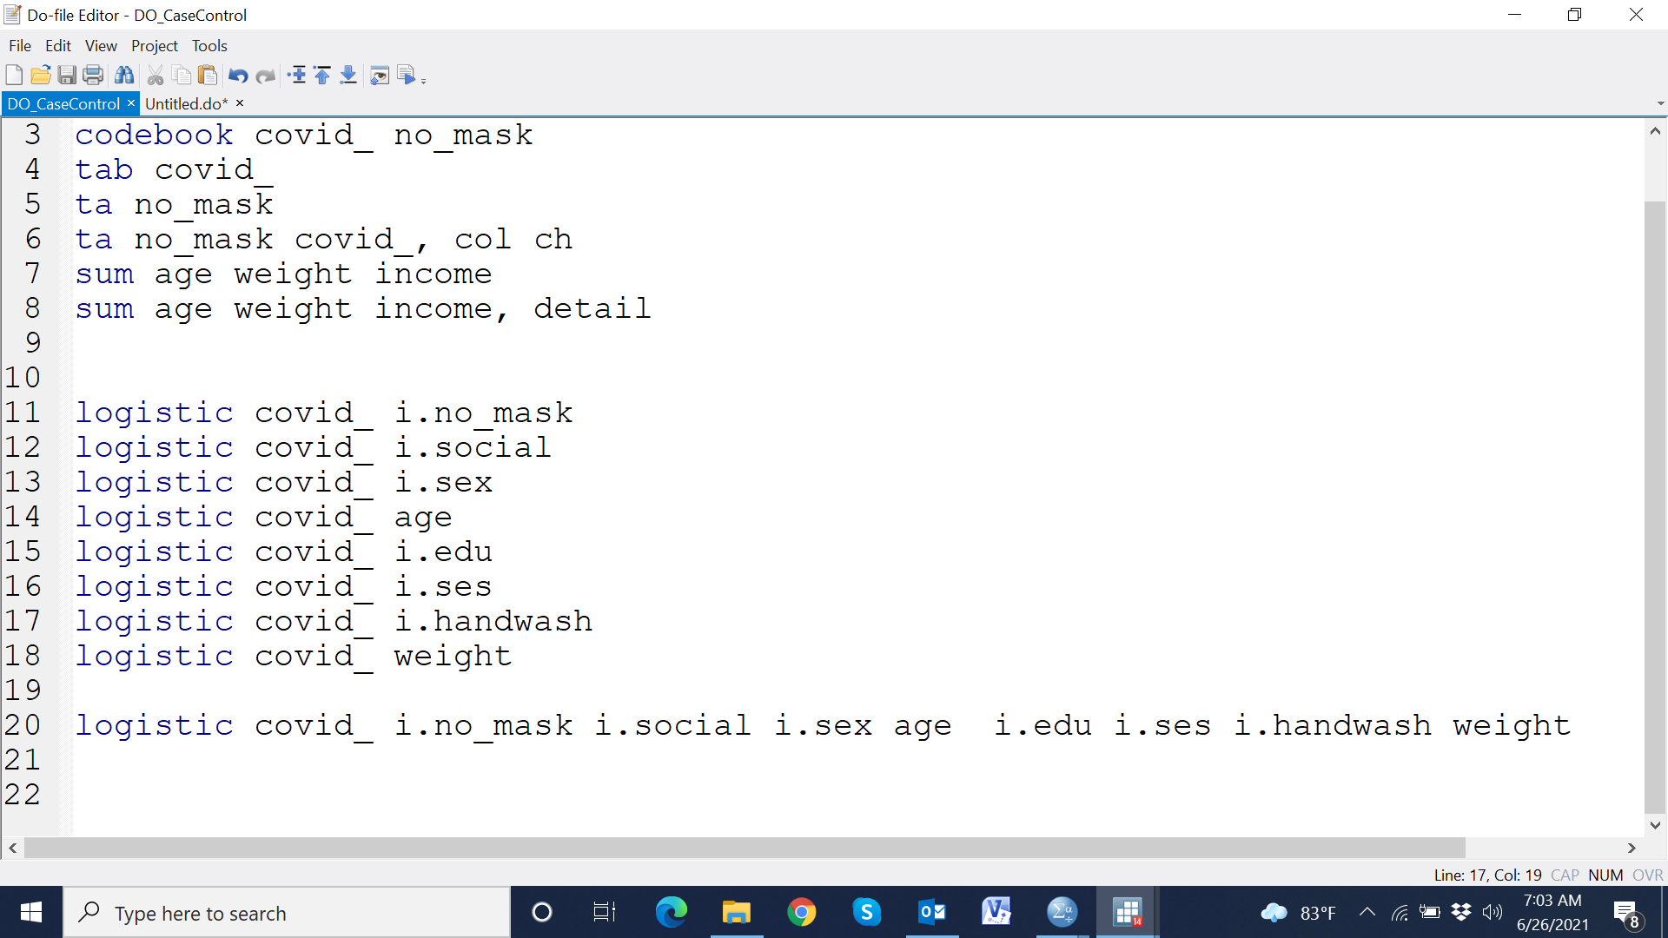

Slide 104
Reference
Harris M, Taylor G. Medical statistics made easy. CRC Press; 2003 Dec 5.

Slide 105
Data Analysis: Multinomial logistic regression analysis
Facilitated by
Md. Ahshanul Haque Maternal and Child Nutrition
Nutrition and Clinical Services Division
E-mail: ahshanul.haque@icddrb.org

Slide 106
Multinomial Logistic regression analysis
Multinomial logistic regression is a simple extension of binary logistic regression
Allow more than two categories within the dependent variable
Does not assume normality, linearity, or homoscedasticity
Explain the relationship between one dependent nominal variable and one or more nominal, ordinal, interval or ratio-level independent variables
Risk ratio or Risk difference also calculated

Slide 107
Example of multinomial Logistic regression analysis
Asses the association between child’s chronic malnutrition and maternal undernutrition
Outcome variable: Chronic malnutrition
Non-stunted (HAZ>=-2)
Moderate stunted (HAZ<-2 &HAZ>=-3)
Severe stunted (HAZ<-3)
Independent variable: Maternal underweight
Normal (BMI>=18.5)
Underweight (BMI<18.5)

Slide 108
Example of multinomial Logistic regression analysis
Asses the association between child’s chronic malnutrition and maternal undernutrition
Outcome variable: Chronic malnutrition
Non-stunted (HAZ>=-2)
Moderate stunted (HAZ<-2 &HAZ>=-3)
Severe stunted (HAZ<-3)
Independent variable: Maternal underweight
Normal (BMI>=18.5)
Underweight (BMI<18.5)

Slide 109
Example of multinomial Logistic regression analysis
Asses the association between child’s chronic malnutrition and maternal undernutrition
Outcome variable: Chronic malnutrition
Non-stunted (HAZ>=-2)
Moderate stunted (HAZ<-2 &HAZ>=-3)
Severe stunted (HAZ<-3)
Independent variable: Maternal underweight
Normal (BMI>=18.5)
Underweight (BMI<18.5)

Slide 110
Example of multinomial Logistic regression analysis
Asses the association between child’s chronic malnutrition and maternal undernutrition
Outcome variable: Chronic malnutrition
Non-stunted (HAZ>=-2)
Moderate stunted (HAZ<-2 &HAZ>=-3)
Severe stunted (HAZ<-3)
Independent variable: Maternal underweight
Normal (BMI>=18.5)
Underweight (BMI<18.5)
General objective: Asses the association between child’s chronic malnutrition and maternal undernutrition

Slide 111
Example of multinomial Logistic regression analysis
Asses the association between child’s chronic malnutrition and maternal undernutrition
Outcome variable: Chronic malnutrition
Non-stunted (HAZ>=-2)
Moderate stunted (HAZ<-2 &HAZ>=-3)
Severe stunted (HAZ<-3)
Independent variable: Maternal underweight
Normal (BMI>=18.5)
Underweight (BMI<18.5)
General objective: Asses the association between child’s chronic malnutrition and maternal undernutrition
Specific objective: Asses the association of the child’s moderate stunted and severe stunted compare to non-stunted with maternal underweight

Slide 112
Example of multinomial Logistic regression analysis
Asses the association between child’s chronic malnutrition and maternal undernutrition
Outcome variable: Chronic malnutrition
Non-stunted (HAZ>=-2)
Moderate stunted (HAZ<-2 &HAZ>=-3)
Severe stunted (HAZ<-3)
Independent variable: Maternal underweight
Normal (BMI>=18.5)
Underweight (BMI<18.5)
General objective: Asses the association between child’s chronic malnutrition and maternal undernutrition
Specific objective: Asses the association of the child’s moderate stunted and severe stunted compare to non-stunted with maternal underweight

Slide 113
Example of multinomial Logistic regression analysis
Outcome variable: Chronic malnutrition
Independent variable: Maternal underweight
Normal (BMI>=18.5)
Underweight (BMI<18.5)
Non-stunted | Non-stunted
Moderate stunted | Moderate stunted
Severe stunted | Severe stunted

Slide 114
Example of multinomial Logistic regression analysis
Outcome variable: Chronic malnutrition
Independent variable: Maternal underweight
Normal (BMI>=18.5)
Underweight (BMI<18.5)
Non-stunted | Non-stunted
Moderate stunted | Moderate stunted
Severe stunted | Severe stunted

Slide 115
Example of multinomial Logistic regression analysis
Outcome variable: Chronic malnutrition
Independent variable: Maternal underweight
Normal (BMI>=18.5)
Underweight (BMI<18.5)
Non-stunted =0 | Non-stunted
Moderate stunted =1 | Moderate stunted
Severe stunted | Severe stunted

Slide 116
Example of multinomial Logistic regression analysis
Outcome variable: Chronic malnutrition
Independent variable: Maternal underweight
Normal (BMI>=18.5)
Underweight (BMI<18.5)
Non-stunted =0 | Non-stunted
Moderate stunted =1 | Moderate stunted
Severe stunted | Severe stunted
Binary logit

Slide 117
Example of multinomial Logistic regression analysis
Outcome variable: Chronic malnutrition
Independent variable: Maternal underweight
Normal (BMI>=18.5)
Underweight (BMI<18.5)
Non-stunted =0 | Non-stunted
Moderate stunted =1 | Moderate stunted
Severe stunted | Severe stunted
Binary logit

Slide 118
Example of multinomial Logistic regression analysis
Outcome variable: Chronic malnutrition
Independent variable: Maternal underweight
Normal (BMI>=18.5)
Underweight (BMI<18.5)
Non-stunted =0 | Non-stunted =0
Moderate stunted =1 | Moderate stunted
Severe stunted | Severe stunted =1
Binary logit

Slide 119
Example of multinomial Logistic regression analysis
Outcome variable: Chronic malnutrition
Independent variable: Maternal underweight
Normal (BMI>=18.5)
Underweight (BMI<18.5)
Non-stunted =0 | Non-stunted =0
Moderate stunted =1 | Moderate stunted
Severe stunted | Severe stunted =1
Binary logit
Binary logit

Slide 120
Example of multinomial Logistic regression analysis
Outcome variable: Chronic malnutrition
Independent variable: Maternal underweight
Normal (BMI>=18.5)
Underweight (BMI<18.5)
Non-stunted =0 | Non-stunted =0
Moderate stunted =1 | Moderate stunted
Severe stunted | Severe stunted =1
Multinomial logistic regression analysis
Binary logit
Binary logit

Slide 121
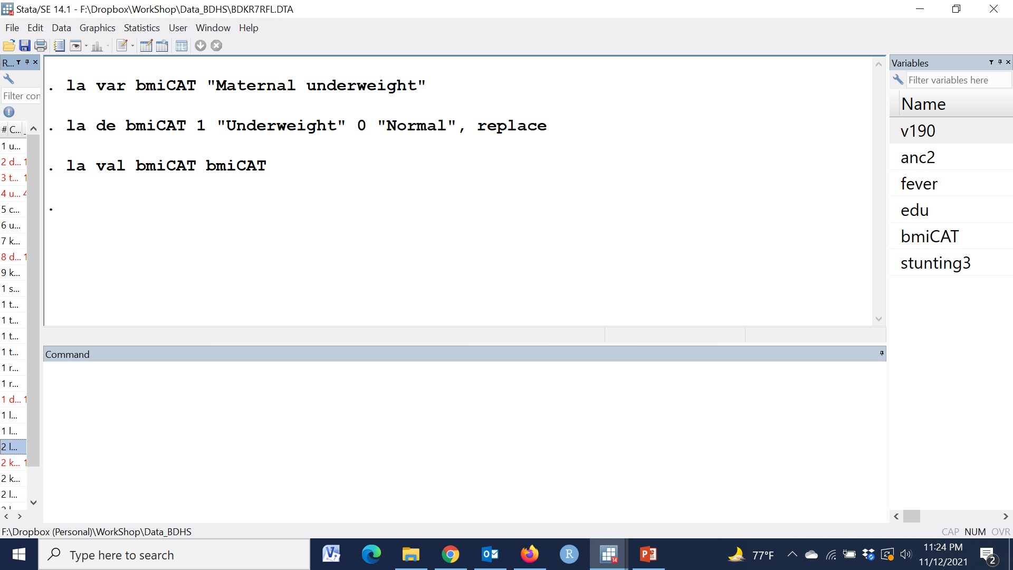

Slide 122
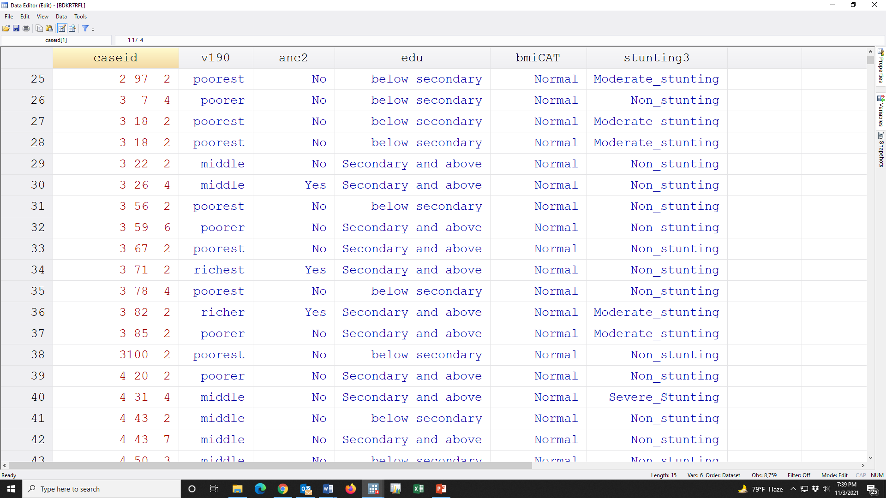

Slide 123
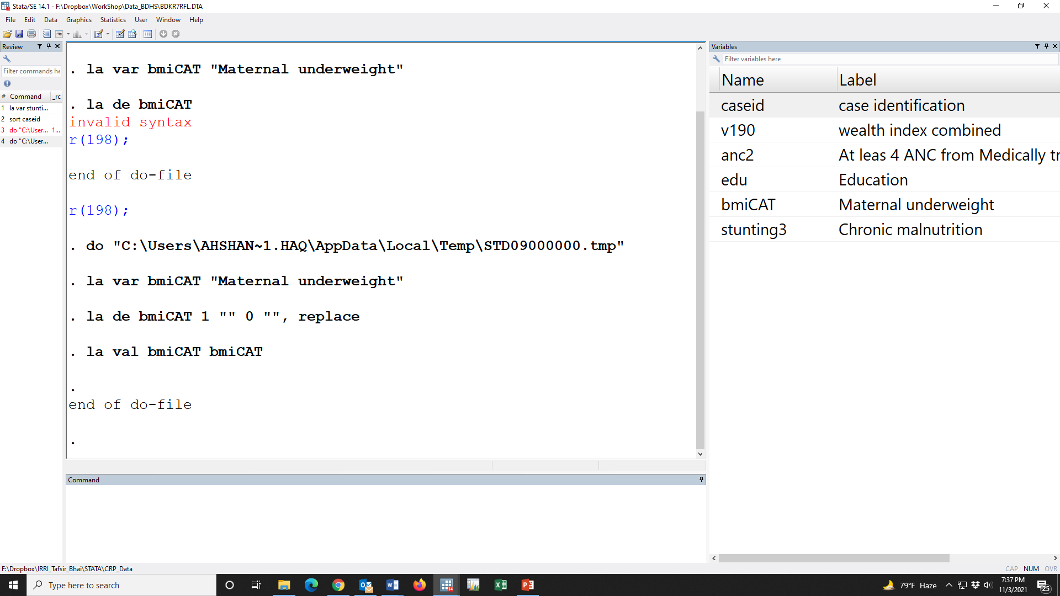

Slide 124
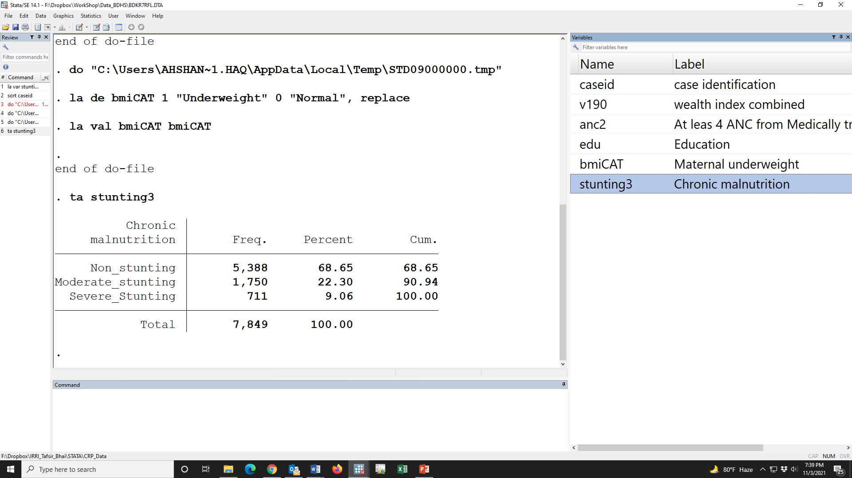

Slide 125
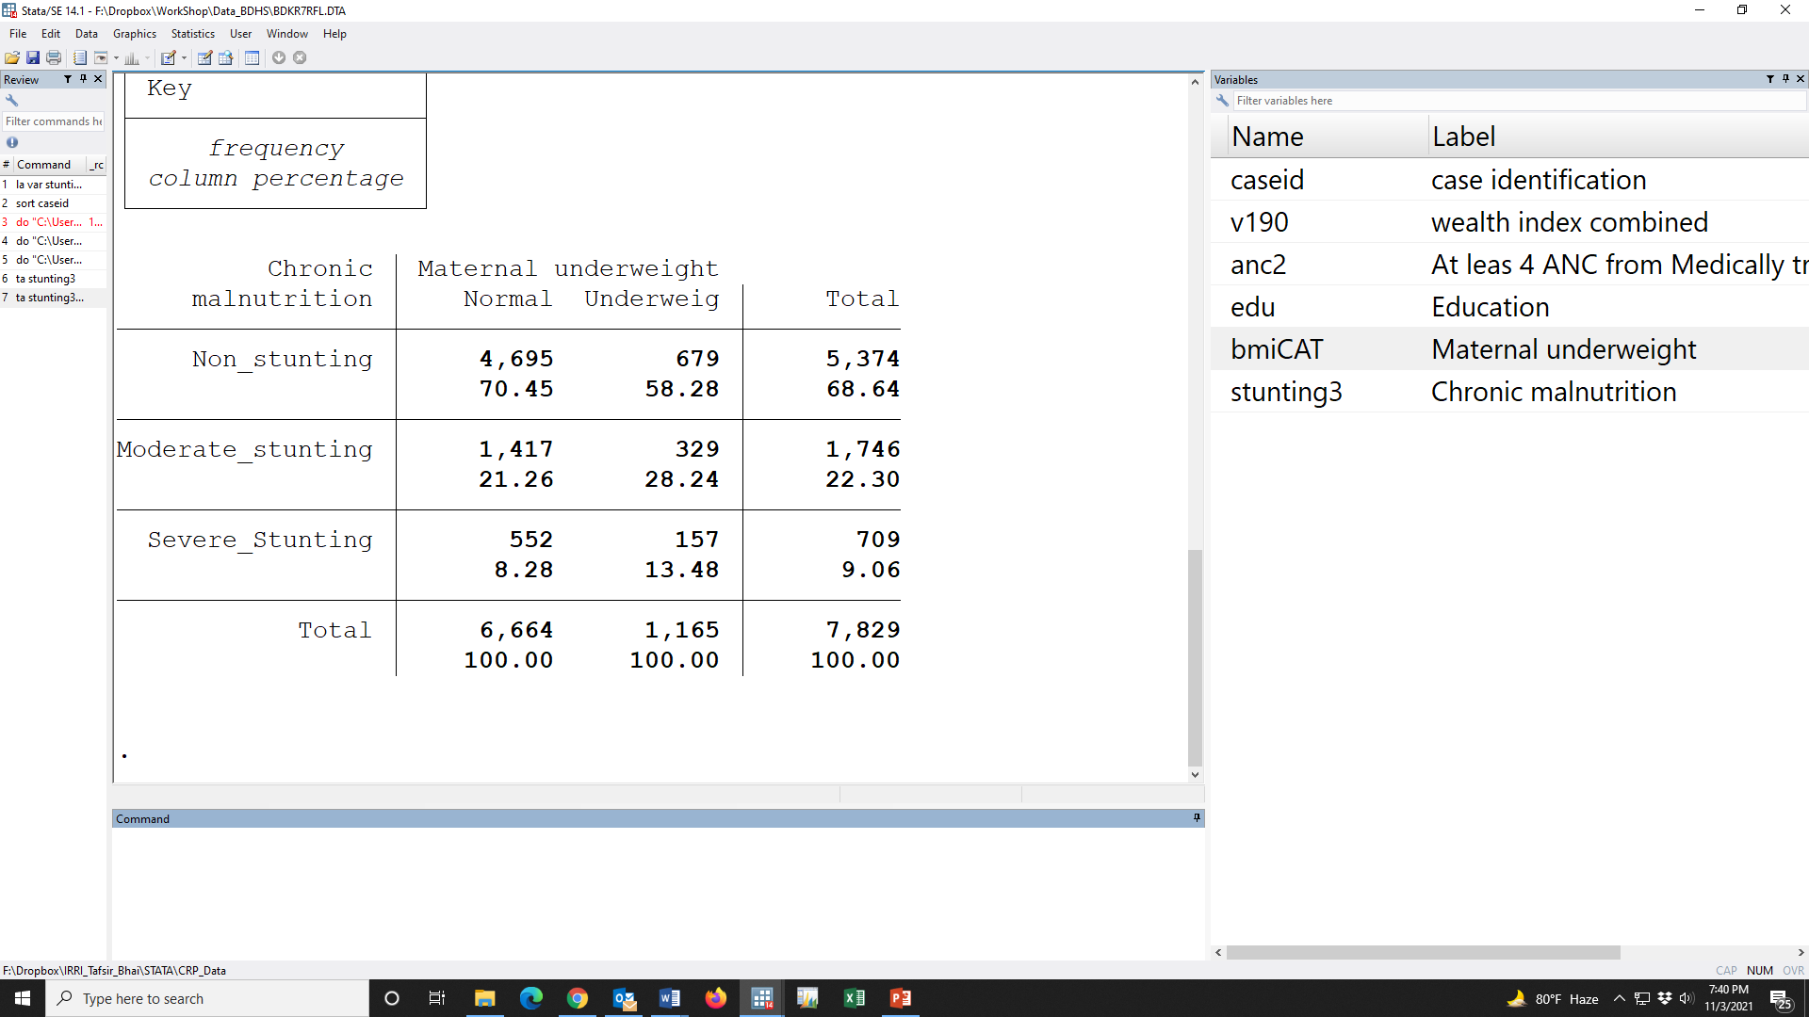

Slide 126
Independent variable
Outcome variable

Slide 127
Reference
Base

Slide 129
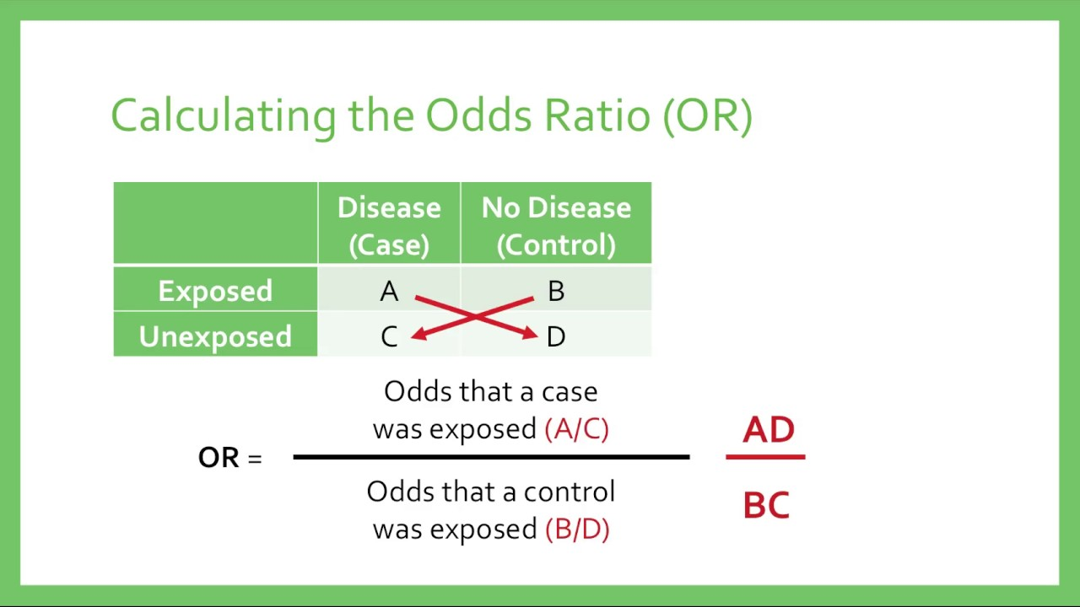

Slide 131
OR=(70.45*28.24)/(58.28*21.26)
=1.60

Slide 133
OR=(70.45*13.48)/(58.28*8.28)
=1.96

Slide 134
RRR: Relative risk ratio
OR=(70.45*13.48)/(58.28*8.28)
=1.96

Slide 135
OR=(70.45*28.24)/(58.28*21.26)
=1.60
OR=(70.45*13.48)/(58.28*8.28)
=1.96

Slide 136
OR=(70.45*28.24)/(58.28*21.26)
=1.60
OR=(70.45*13.48)/(58.28*8.28)
=1.96

Slide 137
OR=(70.45*28.24)/(58.28*21.26)
=1.60
Base
OR=(70.45*13.48)/(58.28*8.28)
=1.96

Slide 138
OR=(70.45*28.24)/(58.28*21.26)
=1.60
Reference
Base
OR=(70.45*13.48)/(58.28*8.28)
=1.96

Slide 139
OR=(70.45*28.24)/(58.28*21.26)
=1.60
Reference
Base
OR=(70.45*13.48)/(58.28*8.28)
=1.96
Odds of having moderate stunting was 1.60 time among those mother who were underweight compared with normal BMI whereas the odds of having severe stunting was 1.96 times

Slide 140
OR=(70.45*28.24)/(58.28*21.26)
=1.60
Reference
Base
P-value ????
Confidence interval ??
OR=(70.45*13.48)/(58.28*8.28)
=1.96
Odds of having moderate stunting was 1.60 time among those mother who were underweight compared with normal BMI whereas the odds of having severe stunting was 1.96 times

Slide 141
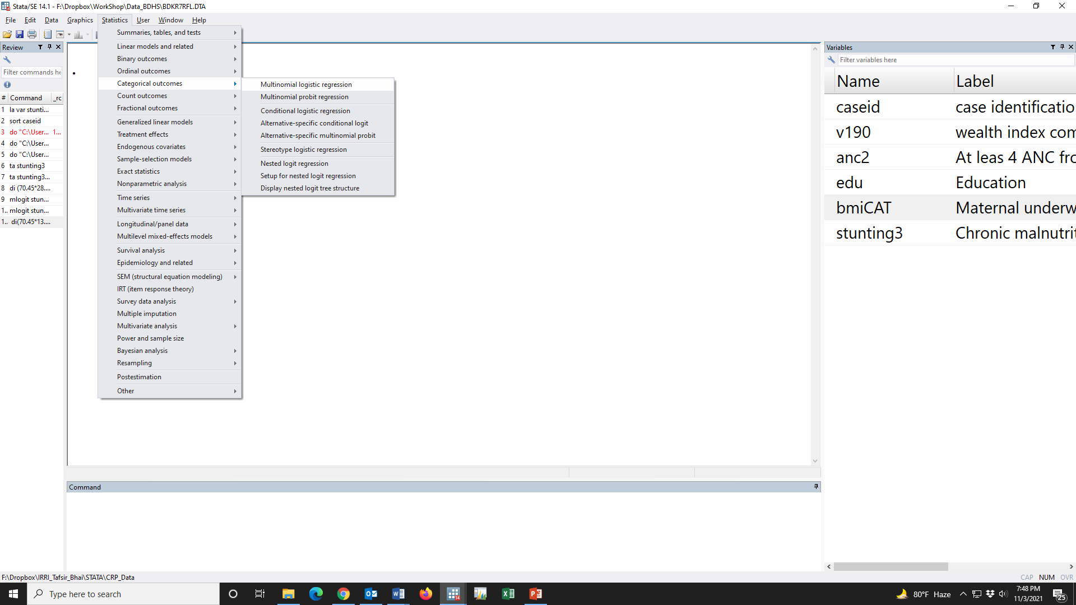

Slide 142
Dependent variable

Slide 143
Independent variable
Dependent variable

Slide 144
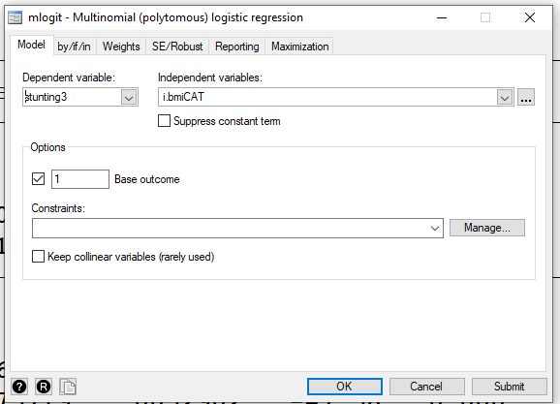

Slide 145
Independent variable
Dependent variable

Slide 146
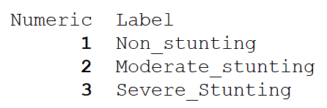

Slide 148
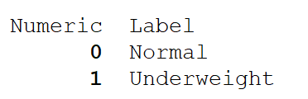

Slide 149
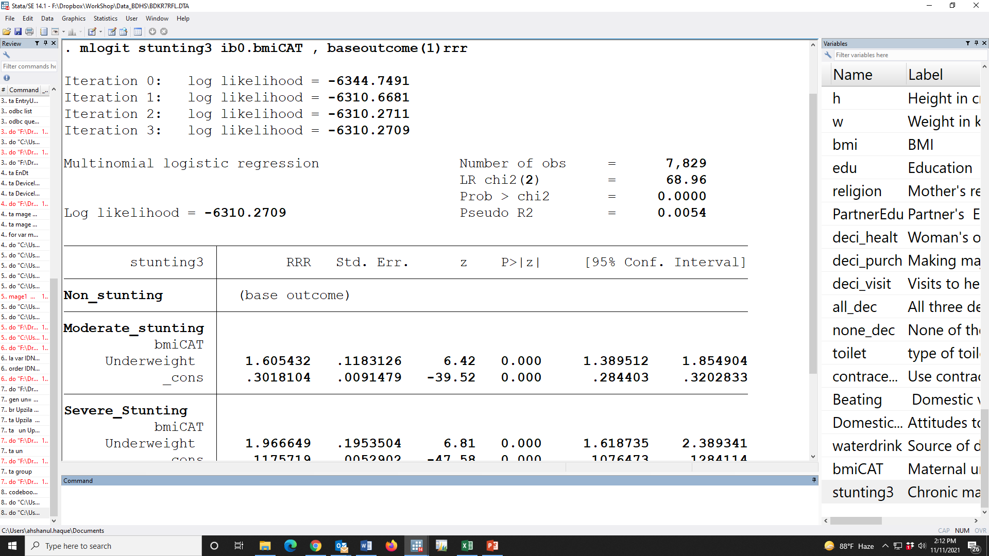

Slide 150
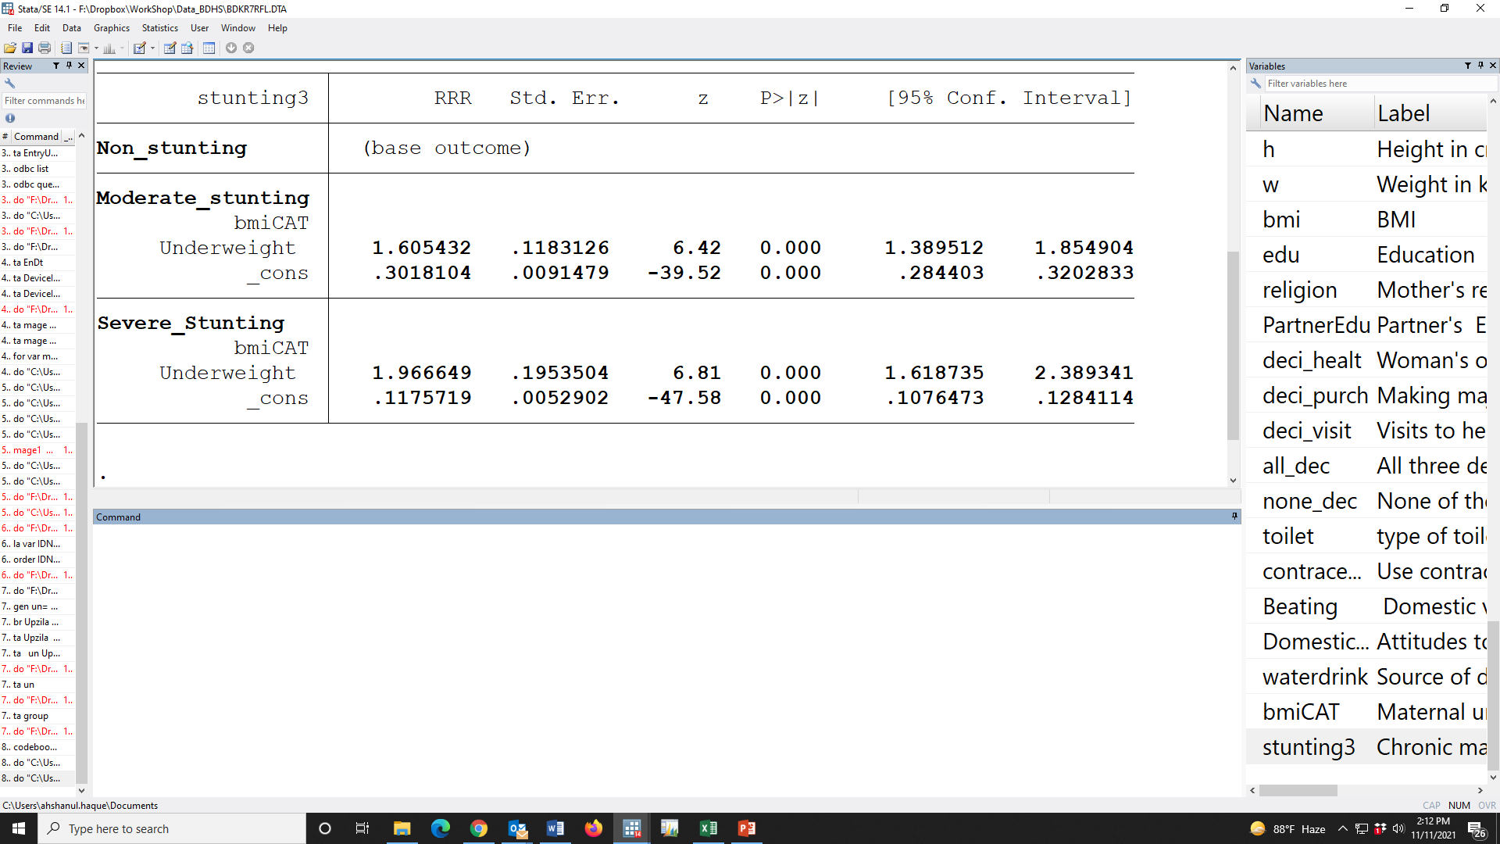
Odds of having moderate stunting was 1.60 time among those mother who were underweight compared with normal BMI whereas the odds of having severe stunting was 1.96 times

Slide 151
Odds of having moderate stunting was 1.60 [mOR: 1.60 (95% CI: 1.39, 1.85); p-value<0.001] time among those mother who were underweight compared with normal BMI whereas the odds of having severe stunting was 1.96 [mOR: 1.96 (95% CI: 1.62, 2.39); p-value<0.001] times which indicate that moderate and severe stunting of children were significantly associated with maternal underweight

Slide 152
Odds of having moderate stunting was 1.60 [mOR: 1.60 (95% CI: 1.39, 1.85); p-value<0.001] time among those mother who were underweight compared with normal BMI whereas the odds of having severe stunting was 1.96 [mOR: 1.96 (95% CI: 1.62, 2.39); p-value<0.001] times which indicate that moderate and severe stunting of children were significantly associated with maternal underweight

Slide 153
Maternal BMI
Stunting3

Slide 154
ANC
SES
Maternal BMI
Stunting3
Morbidity
Edu

Slide 155
ANC
SES
Maternal BMI
Stunting3
Morbidity
Edu

Slide 156
ANC
SES
Maternal BMI
Stunting3
Morbidity
Edu

Slide 157
Odds of having moderate stunting was 1.60 [mOR: 1.60 (95% CI: 1.39, 1.85); p-value<0.001] time among those mother who were underweight compared with normal BMI whereas the odds of having severe stunting was 1.96 [mOR: 1.96 (95% CI: 1.62, 2.39); p-value<0.001] times which indicate that moderate and severe stunting of children were significantly associated with maternal underweight

Slide 158
Moderate stunting Compared with non-stunting
 |  | OR (95% CI) | p-value | aOR (95% CI) | p-value
Maternal Underweight
 | Normal | Reference
 | Underweight | 1.61 (1.39, 1.85) | 0.000 | 1.34 (1.16, 1.56) | 0.000
ANC
 | Yes
 | No | 1.41 (1.24, 1.60) | 0.000 | 1.14 (1.00, 1.31) | 0.049
Having fever
 | No
 | Yes | 1.07 (0.96, 1.20) | 0.237 | 1.04 (0.92, 1.17) | 0.527
Education
 | Secondary/above
 | Below secondary | 1.70 (1.52, 1.90) | 0.000 | 1.33 (1.18, 1.50) | 0.000
Wealth index
 | Richest
 | Poorest | 3.03 (2.52, 3.64) | 0.000 | 2.39 (1.96, 2.92) | 0.000
 | Poorer | 2.83 (2.34, 3.41) | 0.000 | 2.38 (1.96, 2.90) | 0.000
 | Middle | 2.10 (1.73, 2.56) | 0.000 | 1.87 (1.53, 2.28) | 0.000
 | Richer | 1.78 (1.47, 2.17) | 0.000 | 1.63 (1.34, 1.99) | 0.000

Slide 159
Severe stunting Compared with non-stunting
 |  | OR (95% CI) | p-value | aOR (95% CI) | p-value
Maternal Underweight
 | Normal | Reference
 | Underweight | 1.97 (1.62, 2.39) | 0.000 | 1.54 (1.26, 1.88) | 0.000
ANC
 | Yes
 | No | 1.6 (1.32, 1.94) | 0.000 | 1.15 (0.94, 1.4) | 0.187
Having fever
 | No
 | Yes | 1.06 (0.9, 1.25) | 0.508 | 1.02 (0.86, 1.2) | 0.848
Education
 | Secondary/above
 | Below secondary | 2.57 (2.2, 3.01) | 0.000 | 1.91 (1.61, 2.26) | 0.000
Wealth index
 | Richest
 | Poorest | 4.41 (3.31, 5.89) | 0.000 | 2.80 (2.06, 3.82) | 0.000
 | Poorer | 3.84 (2.86, 5.16) | 0.000 | 2.76 (2.03, 3.75) | 0.000
 | Middle | 2.37 (1.73, 3.25) | 0.000 | 1.92 (1.39, 2.64) | 0.000
 | Richer | 1.96 (1.43, 2.69) | 0.000 | 1.66 (1.20, 2.29) | 0.002

Slide 160
Severe stunting Compared with non-stunting
 |  | OR (95% CI) | p-value | aOR (95% CI) | p-value
Maternal Underweight
 | Normal | Reference
 | Underweight | 1.97 (1.62, 2.39) | 0.000 | 1.54 (1.26, 1.88) | 0.000
ANC
 | Yes
 | No | 1.6 (1.32, 1.94) | 0.000 | 1.15 (0.94, 1.4) | 0.187
Having fever
 | No
 | Yes | 1.06 (0.9, 1.25) | 0.508 | 1.02 (0.86, 1.2) | 0.848
Education
 | Secondary/above
 | Below secondary | 2.57 (2.2, 3.01) | 0.000 | 1.91 (1.61, 2.26) | 0.000
Wealth index
 | Richest
 | Poorest | 4.41 (3.31, 5.89) | 0.000 | 2.80 (2.06, 3.82) | 0.000
 | Poorer | 3.84 (2.86, 5.16) | 0.000 | 2.76 (2.03, 3.75) | 0.000
 | Middle | 2.37 (1.73, 3.25) | 0.000 | 1.92 (1.39, 2.64) | 0.000
 | Richer | 1.96 (1.43, 2.69) | 0.000 | 1.66 (1.20, 2.29) | 0.002

Slide 161
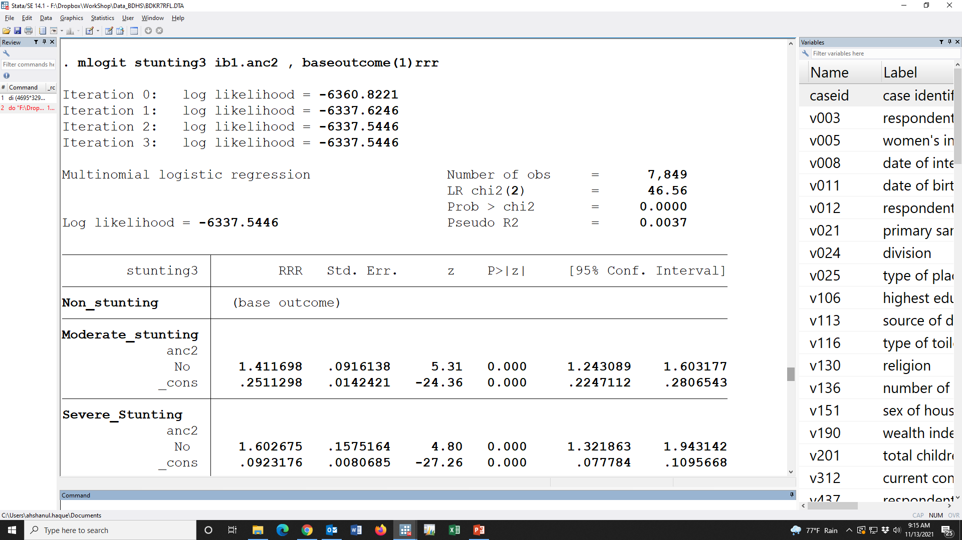

Slide 162
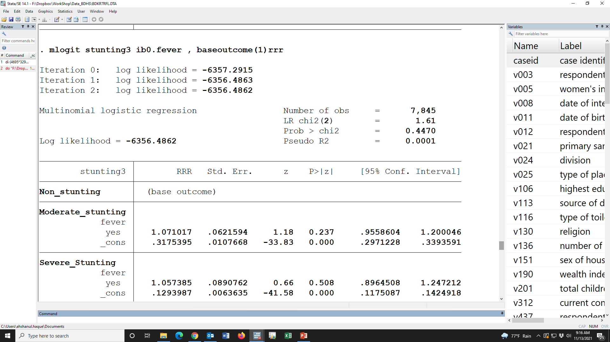

Slide 163
Moderate stunting Compared with non-stunting
 |  | OR (95% CI) | p-value | aOR (95% CI) | p-value
Maternal Underweight
 | Normal | Reference
 | Underweight | 1.61 (1.39, 1.85) | 0.000 | 1.34 (1.16, 1.56) | 0.000
ANC
 | Yes | Reference
 | No | 1.41 (1.24, 1.60) | 0.000 | 1.14 (1.00, 1.31) | 0.049
Having fever
 | No | Reference
 | Yes | 1.07 (0.96, 1.20) | 0.237 | 1.04 (0.92, 1.17) | 0.527
Education
 | Secondary/above | Reference
 | Below secondary | 1.70 (1.52, 1.90) | 0.000 | 1.33 (1.18, 1.50) | 0.000
Wealth index
 | Richest | Reference
 | Poorest | 3.03 (2.52, 3.64) | 0.000 | 2.39 (1.96, 2.92) | 0.000
 | Poorer | 2.83 (2.34, 3.41) | 0.000 | 2.38 (1.96, 2.90) | 0.000
 | Middle | 2.10 (1.73, 2.56) | 0.000 | 1.87 (1.53, 2.28) | 0.000
 | Richer | 1.78 (1.47, 2.17) | 0.000 | 1.63 (1.34, 1.99) | 0.000

Slide 164
Severe stunting Compared with non-stunting
 |  | OR (95% CI) | p-value | aOR (95% CI) | p-value
Maternal Underweight
 | Normal | Reference
 | Underweight | 1.97 (1.62, 2.39) | 0.000 | 1.54 (1.26, 1.88) | 0.000
ANC
 | Yes | Reference
 | No | 1.6 (1.32, 1.94) | 0.000 | 1.15 (0.94, 1.4) | 0.187
Having fever
 | No | Reference
 | Yes | 1.06 (0.9, 1.25) | 0.508 | 1.02 (0.86, 1.2) | 0.848
Education
 | Secondary/above | Reference
 | Below secondary | 2.57 (2.2, 3.01) | 0.000 | 1.91 (1.61, 2.26) | 0.000
Wealth index
 | Richest | Reference
 | Poorest | 4.41 (3.31, 5.89) | 0.000 | 2.80 (2.06, 3.82) | 0.000
 | Poorer | 3.84 (2.86, 5.16) | 0.000 | 2.76 (2.03, 3.75) | 0.000
 | Middle | 2.37 (1.73, 3.25) | 0.000 | 1.92 (1.39, 2.64) | 0.000
 | Richer | 1.96 (1.43, 2.69) | 0.000 | 1.66 (1.20, 2.29) | 0.002

Slide 165
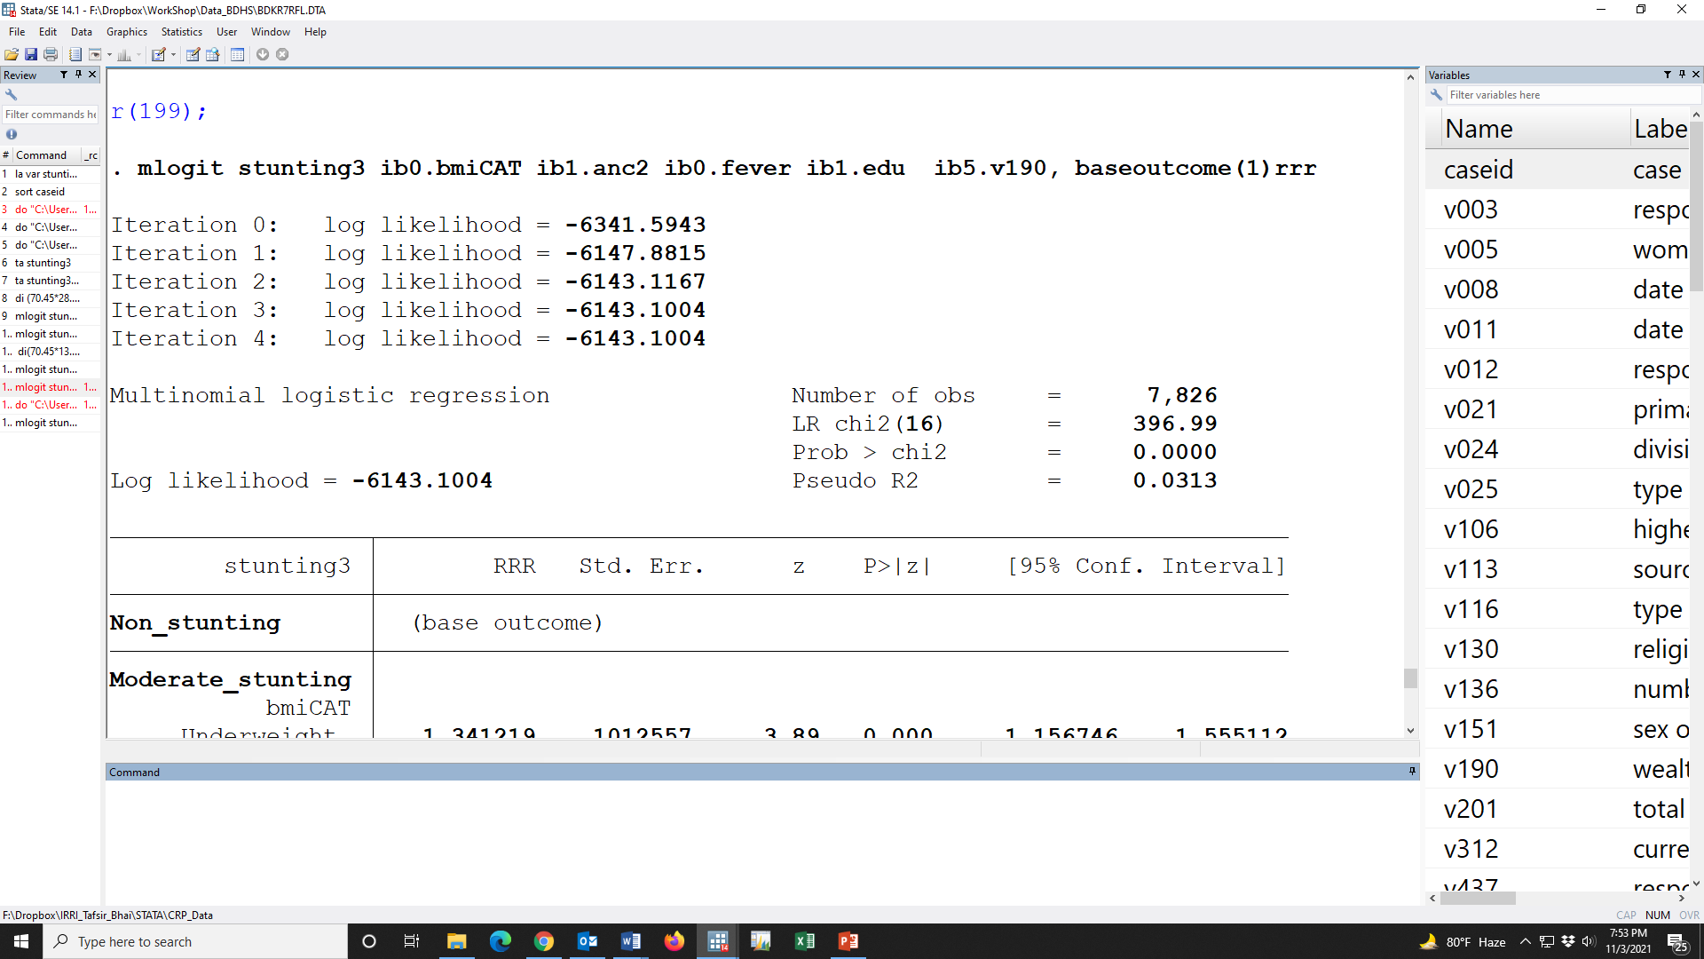

Slide 167
ANC
SES
Maternal BMI
Stunting3
Morbidity
Edu

Slide 169
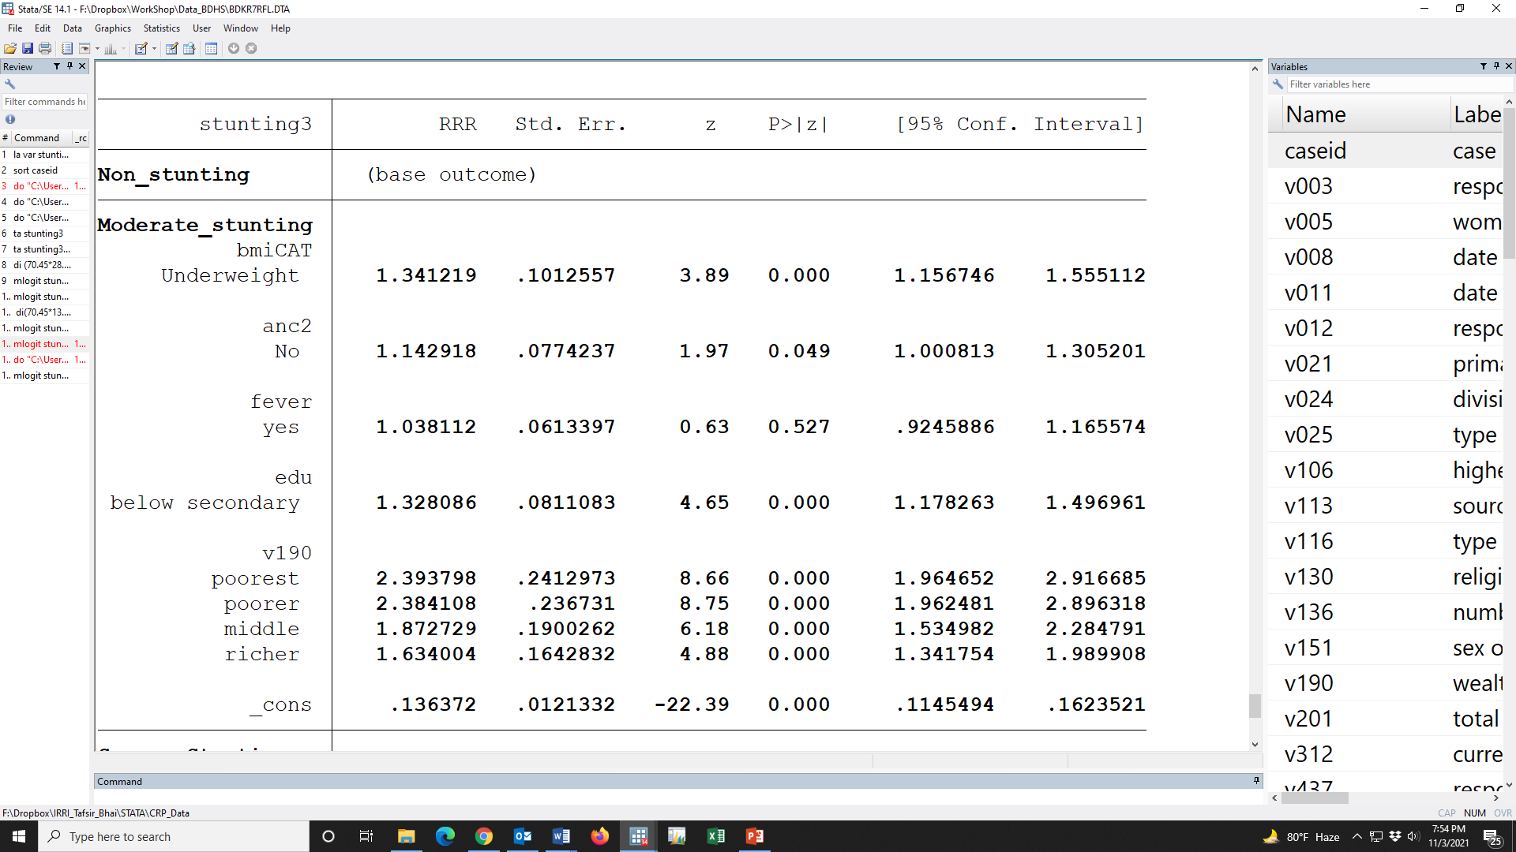

Slide 170
Moderate stunting Compared with non-stunting
 |  | OR (95% CI) | p-value | aOR (95% CI) | p-value
Maternal Underweight
 | Normal | Reference |  | Reference
 | Underweight | 1.61 (1.39, 1.85) | 0.000 | 1.34 (1.16, 1.56) | 0.000
ANC
 | Yes | Reference |  | Reference
 | No | 1.41 (1.24, 1.60) | 0.000 | 1.14 (1.00, 1.31) | 0.049
Having fever
 | No | Reference |  | Reference
 | Yes | 1.07 (0.96, 1.20) | 0.237 | 1.04 (0.92, 1.17) | 0.527
Education
 | Secondary/above | Reference |  | Reference
 | Below secondary | 1.70 (1.52, 1.90) | 0.000 | 1.33 (1.18, 1.50) | 0.000
Wealth index
 | Richest | Reference |  | Reference
 | Poorest | 3.03 (2.52, 3.64) | 0.000 | 2.39 (1.96, 2.92) | 0.000
 | Poorer | 2.83 (2.34, 3.41) | 0.000 | 2.38 (1.96, 2.90) | 0.000
 | Middle | 2.10 (1.73, 2.56) | 0.000 | 1.87 (1.53, 2.28) | 0.000
 | Richer | 1.78 (1.47, 2.17) | 0.000 | 1.63 (1.34, 1.99) | 0.000

Slide 171
Moderate stunting Compared with non-stunting
 |  | OR (95% CI) | p-value | aOR (95% CI) | p-value
Maternal Underweight
 | Normal | Reference |  | Reference
 | Underweight | 1.61 (1.39, 1.85) | 0.000 | 1.34 (1.16, 1.56) | 0.000
ANC
 | Yes | Reference |  | Reference
 | No | 1.41 (1.24, 1.60) | 0.000 | 1.14 (1.00, 1.31) | 0.049
Having fever
 | No | Reference |  | Reference
 | Yes | 1.07 (0.96, 1.20) | 0.237 | 1.04 (0.92, 1.17) | 0.527
Education
 | Secondary/above | Reference |  | Reference
 | Below secondary | 1.70 (1.52, 1.90) | 0.000 | 1.33 (1.18, 1.50) | 0.000
Wealth index
 | Richest | Reference |  | Reference
 | Poorest | 3.03 (2.52, 3.64) | 0.000 | 2.39 (1.96, 2.92) | 0.000
 | Poorer | 2.83 (2.34, 3.41) | 0.000 | 2.38 (1.96, 2.90) | 0.000
 | Middle | 2.10 (1.73, 2.56) | 0.000 | 1.87 (1.53, 2.28) | 0.000
 | Richer | 1.78 (1.47, 2.17) | 0.000 | 1.63 (1.34, 1.99) | 0.000

Slide 172
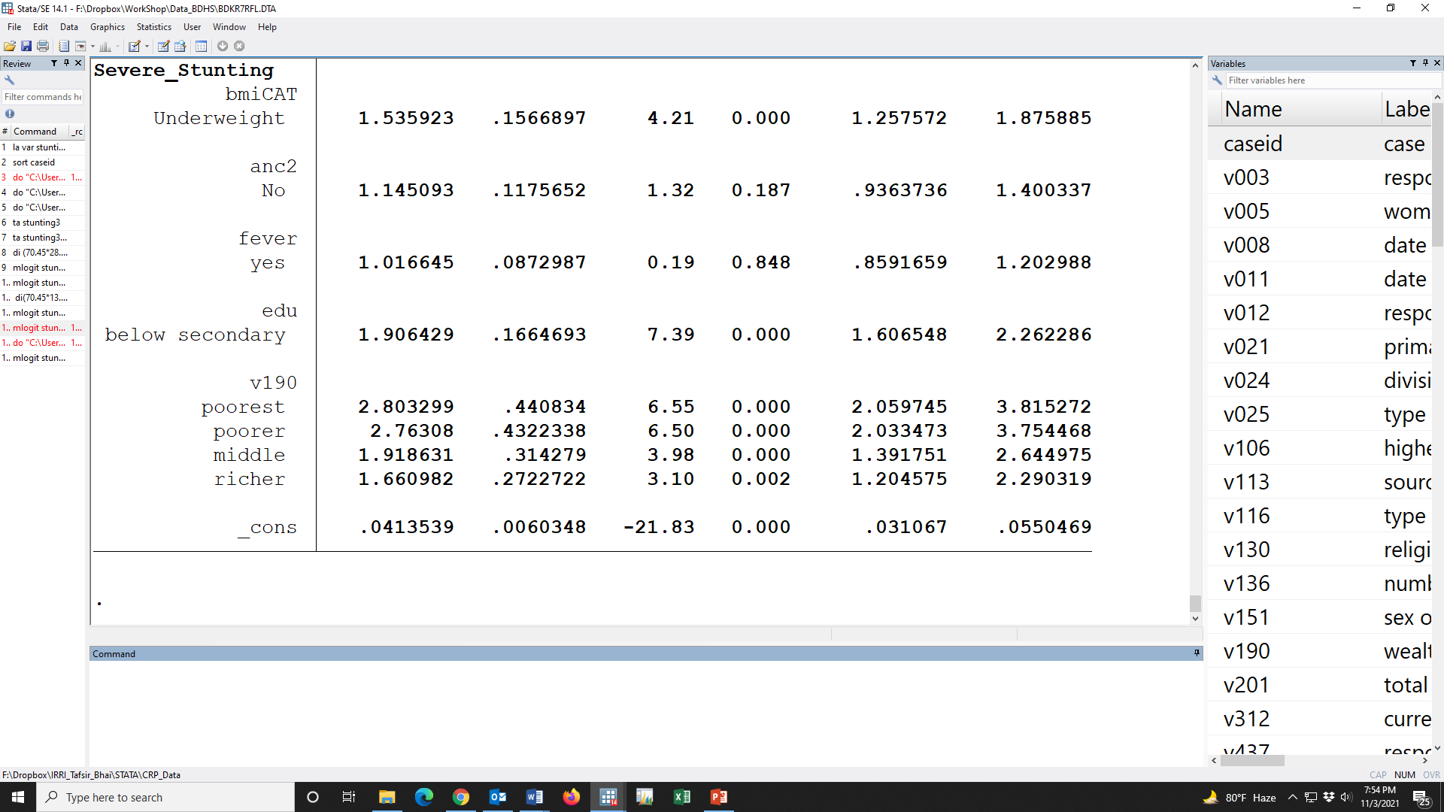

Slide 173
Severe stunting Compared with non-stunting
 |  | OR (95% CI) | p-value | aOR (95% CI) | p-value
Maternal Underweight
 | Normal | Reference |  | Reference
 | Underweight | 1.97 (1.62, 2.39) | 0.000 | 1.54 (1.26, 1.88) | 0.000
ANC
 | Yes | Reference |  | Reference
 | No | 1.6 (1.32, 1.94) | 0.000 | 1.15 (0.94, 1.4) | 0.187
Having fever
 | No | Reference |  | Reference
 | Yes | 1.06 (0.9, 1.25) | 0.508 | 1.02 (0.86, 1.2) | 0.848
Education
 | Secondary/above | Reference |  | Reference
 | Below secondary | 2.57 (2.2, 3.01) | 0.000 | 1.91 (1.61, 2.26) | 0.000
Wealth index
 | Richest | Reference |  | Reference
 | Poorest | 4.41 (3.31, 5.89) | 0.000 | 2.80 (2.06, 3.82) | 0.000
 | Poorer | 3.84 (2.86, 5.16) | 0.000 | 2.76 (2.03, 3.75) | 0.000
 | Middle | 2.37 (1.73, 3.25) | 0.000 | 1.92 (1.39, 2.64) | 0.000
 | Richer | 1.96 (1.43, 2.69) | 0.000 | 1.66 (1.20, 2.29) | 0.002

Slide 174
Severe stunting Compared with non-stunting
 |  | OR (95% CI) | p-value | aOR (95% CI) | p-value
Maternal Underweight
 | Normal | Reference |  | Reference
 | Underweight | 1.97 (1.62, 2.39) | 0.000 | 1.54 (1.26, 1.88) | 0.000
ANC
 | Yes | Reference |  | Reference
 | No | 1.6 (1.32, 1.94) | 0.000 | 1.15 (0.94, 1.4) | 0.187
Having fever
 | No | Reference |  | Reference
 | Yes | 1.06 (0.9, 1.25) | 0.508 | 1.02 (0.86, 1.2) | 0.848
Education
 | Secondary/above | Reference |  | Reference
 | Below secondary | 2.57 (2.2, 3.01) | 0.000 | 1.91 (1.61, 2.26) | 0.000
Wealth index
 | Richest | Reference |  | Reference
 | Poorest | 4.41 (3.31, 5.89) | 0.000 | 2.80 (2.06, 3.82) | 0.000
 | Poorer | 3.84 (2.86, 5.16) | 0.000 | 2.76 (2.03, 3.75) | 0.000
 | Middle | 2.37 (1.73, 3.25) | 0.000 | 1.92 (1.39, 2.64) | 0.000
 | Richer | 1.96 (1.43, 2.69) | 0.000 | 1.66 (1.20, 2.29) | 0.002

Slide 175
Table ##. Association of Moderate stunting and Severe stunting maternal underweight
 |  | Moderate stunting |  | Severe stunting
 |  | aRRR (95% CI) | p-value | aRRR (95% CI) | p-value
Maternal Underweight
 | Normal | Reference |  | Reference
 | Underweight | 1.34 (1.16, 1.56) | 0.000 | 1.54 (1.26, 1.88) | 0.000
ANC
 | Yes | Reference |  | Reference
 | No | 1.14 (1.00, 1.31) | 0.049 | 1.15 (0.94, 1.4) | 0.187
Having fever
 | No | Reference |  | Reference
 | Yes | 1.04 (0.92, 1.17) | 0.527 | 1.02 (0.86, 1.2) | 0.848
Education
 | Secondary/above | Reference |  | Reference
 | Below secondary | 1.33 (1.18, 1.50) | 0.000 | 1.91 (1.61, 2.26) | 0.000
Wealth index
 | Richest | Reference |  | Reference
 | Poorest | 2.39 (1.96, 2.92) | 0.000 | 2.80 (2.06, 3.82) | 0.000
 | Poorer | 2.38 (1.96, 2.90) | 0.000 | 2.76 (2.03, 3.75) | 0.000
 | Middle | 1.87 (1.53, 2.28) | 0.000 | 1.92 (1.39, 2.64) | 0.000
 | Richer | 1.63 (1.34, 1.99) | 0.000 | 1.66 (1.20, 2.29) | 0.002

Slide 176
Table ##. Association of Moderate stunting and Severe stunting maternal underweight
 |  | Moderate stunting |  | Severe stunting
 |  | aRRR (95% CI) | p-value | aRRR (95% CI) | p-value
Maternal Underweight
 | Normal | Reference |  | Reference
 | Underweight | 1.34 (1.16, 1.56) | 0.000 | 1.54 (1.26, 1.88) | 0.000
ANC
 | Yes | Reference |  | Reference
 | No | 1.14 (1.00, 1.31) | 0.049 | 1.15 (0.94, 1.4) | 0.187
Having fever
 | No | Reference |  | Reference
 | Yes | 1.04 (0.92, 1.17) | 0.527 | 1.02 (0.86, 1.2) | 0.848
Education
 | Secondary/above | Reference |  | Reference
 | Below secondary | 1.33 (1.18, 1.50) | 0.000 | 1.91 (1.61, 2.26) | 0.000
Wealth index
 | Richest | Reference |  | Reference
 | Poorest | 2.39 (1.96, 2.92) | 0.000 | 2.80 (2.06, 3.82) | 0.000
 | Poorer | 2.38 (1.96, 2.90) | 0.000 | 2.76 (2.03, 3.75) | 0.000
 | Middle | 1.87 (1.53, 2.28) | 0.000 | 1.92 (1.39, 2.64) | 0.000
 | Richer | 1.63 (1.34, 1.99) | 0.000 | 1.66 (1.20, 2.29) | 0.002
After adjusting the relevant covariates, Odds of having moderate stunting was 1.34 [mOR: 1.34 (95% CI: 1.16, 1.56); p-value<0.001] time among those mother who were underweight compared with normal BMI whereas the odds of having severe stunting was 1.54 [mOR: 1.54 (95% CI: 1.26, 1.88); p-value<0.001] times which indicate that moderate and severe stunting of children were significantly associated with maternal underweight

Slide 177
Table ##. Association of Moderate stunting and Severe stunting maternal underweight
 |  | Moderate stunting |  | Severe stunting
 |  | aRRR (95% CI) | p-value | aRRR (95% CI) | p-value
Maternal Underweight
 | Normal | Reference |  | Reference
 | Underweight | 1.34 (1.16, 1.56) | 0.000 | 1.54 (1.26, 1.88) | 0.000
ANC
 | Yes | Reference |  | Reference
 | No | 1.14 (1.00, 1.31) | 0.049 | 1.15 (0.94, 1.4) | 0.187
Having fever
 | No | Reference |  | Reference
 | Yes | 1.04 (0.92, 1.17) | 0.527 | 1.02 (0.86, 1.2) | 0.848
Education
 | Secondary/above | Reference |  | Reference
 | Below secondary | 1.33 (1.18, 1.50) | 0.000 | 1.91 (1.61, 2.26) | 0.000
Wealth index
 | Richest | Reference |  | Reference
 | Poorest | 2.39 (1.96, 2.92) | 0.000 | 2.80 (2.06, 3.82) | 0.000
 | Poorer | 2.38 (1.96, 2.90) | 0.000 | 2.76 (2.03, 3.75) | 0.000
 | Middle | 1.87 (1.53, 2.28) | 0.000 | 1.92 (1.39, 2.64) | 0.000
 | Richer | 1.63 (1.34, 1.99) | 0.000 | 1.66 (1.20, 2.29) | 0.002
After adjusting the relevant covariates, Odds of having moderate stunting was 1.34 [mOR: 1.34 (95% CI: 1.16, 1.56); p-value<0.001] time among those mother who were underweight compared with normal BMI whereas the odds of having severe stunting was 1.54 [mOR: 1.54 (95% CI: 1.26, 1.88); p-value<0.001] times which indicate that moderate and severe stunting of children were significantly associated with maternal underweight

Slide 178
*-----------Unadjusted
mlogit stunting3 ib0.bmiCAT , baseoutcome(1)rrr
mlogit stunting3 ib1.anc2 , baseoutcome(1)rrr
mlogit stunting3 ib0.fever , baseoutcome(1)rrr
mlogit stunting3 ib1.edu , baseoutcome(1)rrr
mlogit stunting3 ib5.v190 , baseoutcome(1)rrr
*---------Adjusted
mlogit stunting3 ib0.bmiCAT ib1.anc2 ib0.fever ib1.edu ib5.v190, baseoutcome(1)rrr

Slide 179
Thank you

